Slide 1
Modeling Gas and Dust Flow in Io’s Pele Plume William McDoniel D. B. Goldstein, P. L. Varghese, L. M. Trafton University of Texas at Austin Department of Aerospace Engineering DSMC Workshop September 28th, 2011 Supported by the NASA Planetary Atmospheres and Outer Planets Research Programs. Computations performed at the Texas Advanced Computing Center.

Slide 2
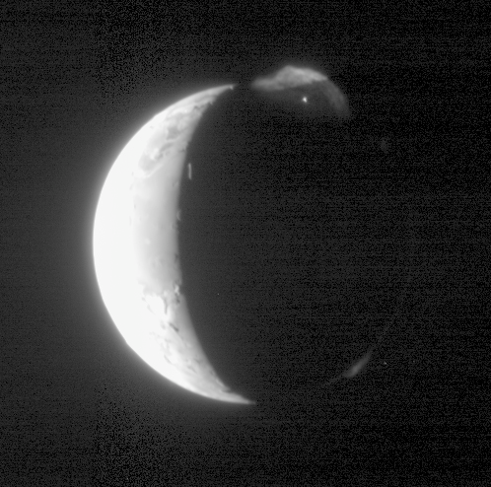
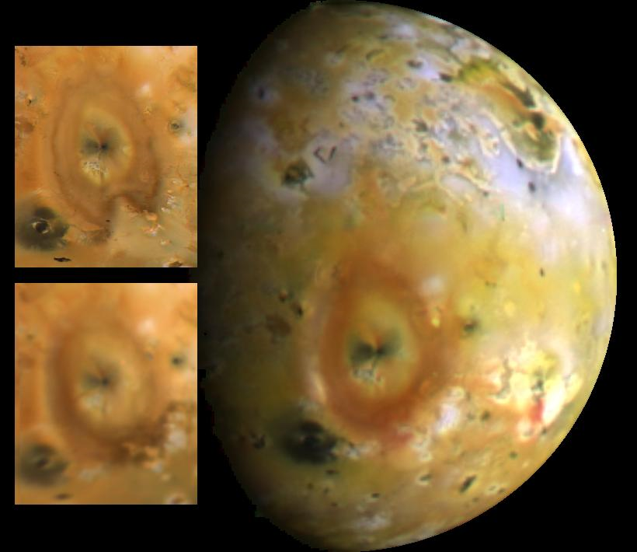
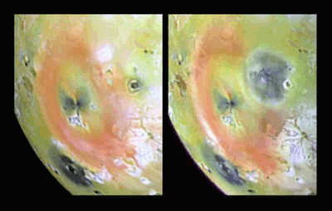
Io’s Plumes
Io is the most volcanically active body in the solar system
The Pele plume rises to over 300km with a deposition ring ~1200km across
Plumes strongly influence the surface and atmosphere
Io’s geology is poorly understood

Slide 3
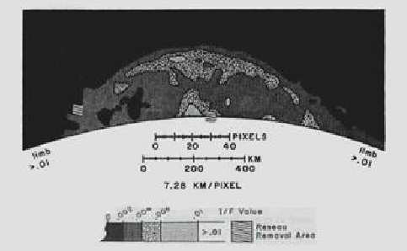
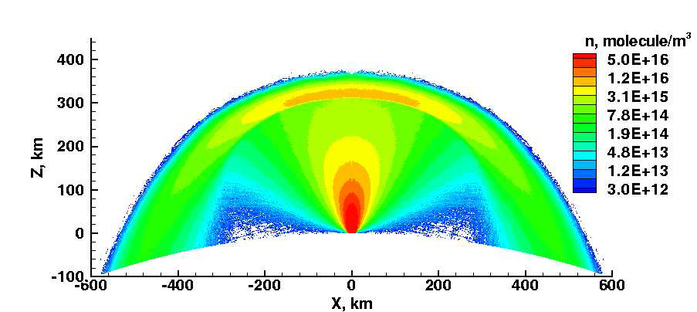
Previous Work
Ju Zhang used Voyager images
Matched plume size and line-of-sight integrated density
Axisymmetric – many observed features couldn’t be simulated

Slide 4
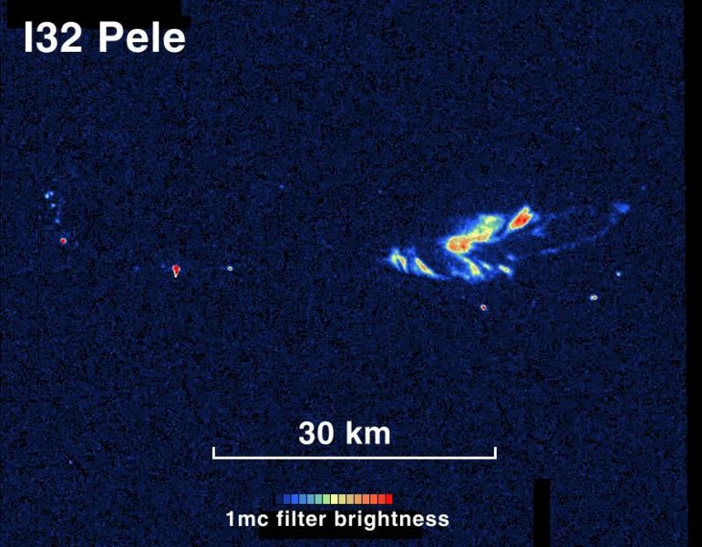
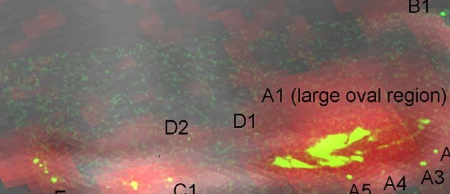
Vent Conditions
Galileo IR images reveal hot spots (>1000K)
Bob Howell (U. of Wyoming) uses similar images to produce a temperature map
We take bright regions of this temperature map as the sources of the simulated plume.
Volume reservoirs created beneath Io’s surface
SO² gas created at 5 × 10¹⁷ mol/m³, 1000 m/s vertical velocity, 650K
Light dust particles are created with very low density at the same velocity and temperature and with diameters uniformly distributed from 30 nm to 2 um

Slide 5
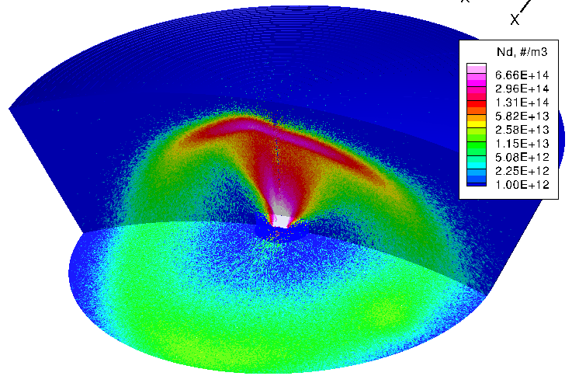
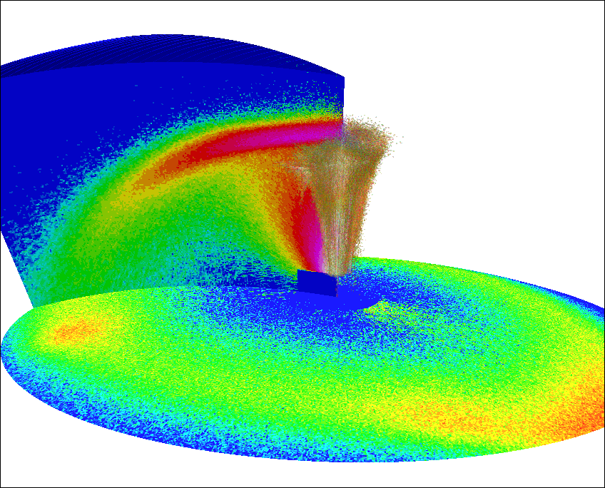
Simulated Plume Features
Rarefied jet expands from the vent
Gas falling back on itself creates a self-sustaining canopy shock
Vent
Canopy Shock
Near-vacuum
Plume Core
Canopy gas falls away to the side creating a deposition ring
Rotation and Vibration
Radiative cooling
Multi-species with large variation in dust diameter
Deposition Ring
~1200km

Slide 6
Scale Variations, Resolution Considerations
Huge scale variations present difficulty for gridding
With DSMC, how important is it to resolve:
The vent geometry?
The gas mean free path?
The boundary geometry must be resolved or else gross inaccuracies arise, especially in dust particles.
This requires cell sizes in the tens of meters near the vent, but gas collisions occur over tens of kilometers further up
30km
The vent is divided up into seven regions, and the first 1-2 kilometers above each region is simulated independently of the other regions.

Slide 7
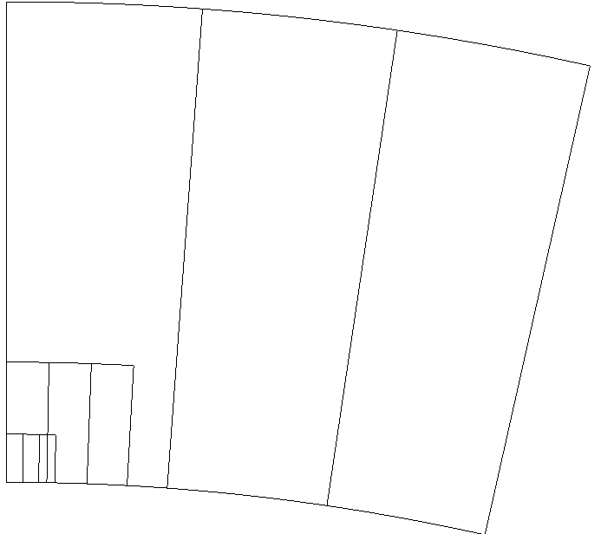
Staging through Multiple Domains
Smaller domains are nested inside of larger domains.
Domain interfaces at 2, 20, and 60 kilometers of altitude
Timestep varies across domains
Three final stages simulated on 360 processors each
~1 billion total molecules in each domain
~50 million cells in each domain
~1 day total wall-clock run-time

Slide 8
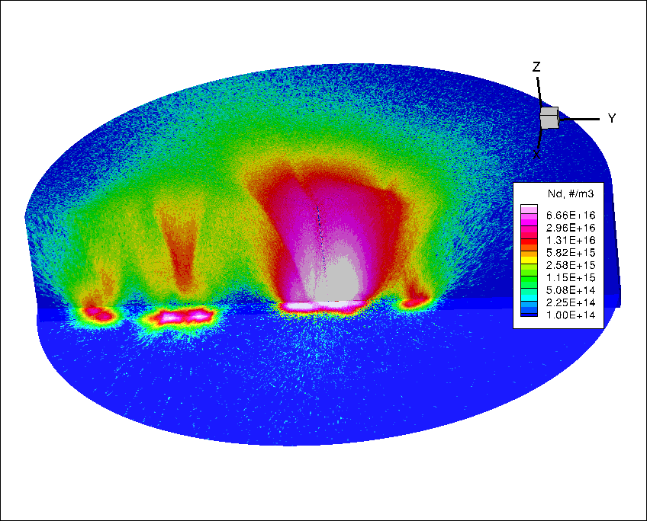
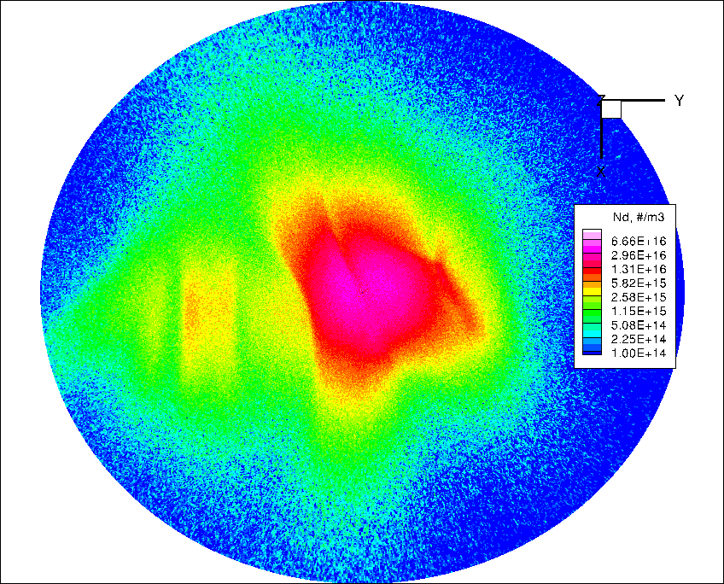
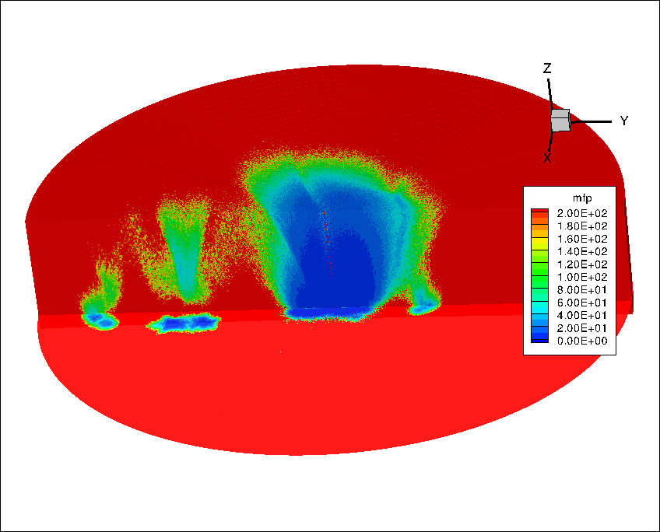
Near-field (up to 20 km)
Number Densities
Mean Free Path
20km altitude slice
Strong 3D effects
-shocks
-converging jets
Different sizes (strengths) of sources explain many features

Slide 9
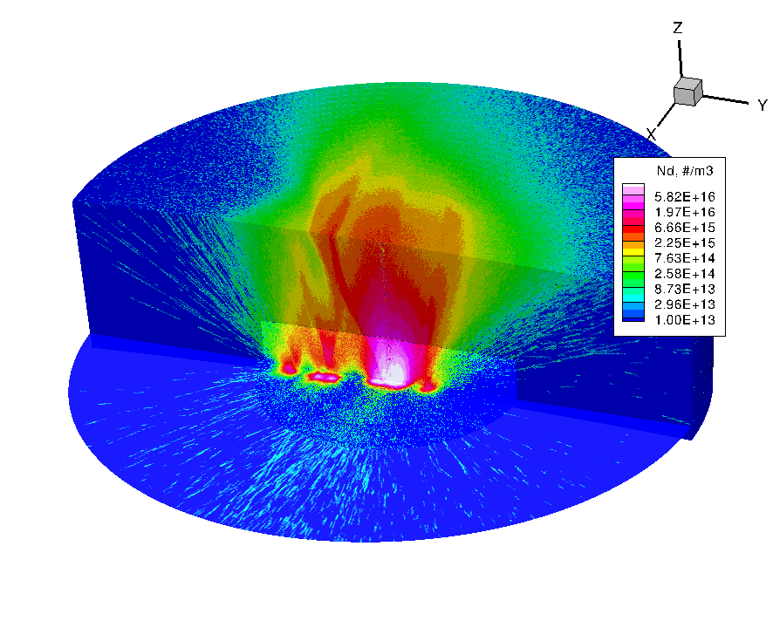
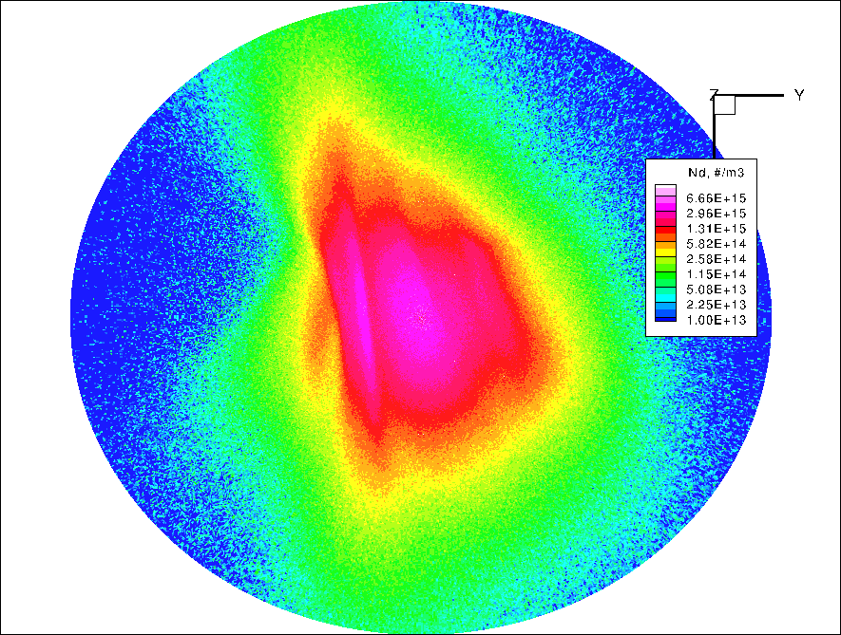
Mid-field (up to 60 km)
Number Densities
Dust
Gas expands much more rapidly than dust
Gas is now mostly distributed north/south – reversed from the vent’s east/west orientation.
Strong oblique shock has formed between the largest vent region and its neighbor
60km altitude slice

Slide 10
Comparisons in Altitude
20km slice
The high-density regions (pink/purple) separate and elongate as the plume expands
60km slice

Slide 11
Far-field Deposition Agreement
Ring Shape and Alignment
Low-altitude gas jets
Gas
Dust
Dust fans

Slide 12
Constant Altitude Slices (Gas)
Number density contours from surface level to 500km in 40 frames.

Slide 13
Far-field Gas Side-view
Number density contours starting from 6 o’clock and proceeding counter-clockwise in 40 frames.

Slide 14
Far-field Dust Side-view

Slide 15
Conclusions
We have a very good model of gas and dust flow in Pele which successfully matches observations
The complicated nature of the vent is very important for producing the observed deposition features
Partial dust/gas decoupling is responsible for the different orientations of the gas jets/ring and the dust fans on the surface.

