Slide 1
3D DSMC Simulations of Io’s Unsteady Sublimation-Driven Atmosphere and Its Sensitivity to the Lower Surface Boundary Conditions
Andrew Walker
D. B. Goldstein, P. L. Varghese, L. M. Trafton, C. H. Moore
University of Texas at Austin
Department of Aerospace Engineering
DSMC Workshop
September 28th, 2011
Supported by the NASA Planetary Atmospheres and Outer Planets Research Programs.
Computations performed at the Texas Advanced Computing Center.

Slide 2
Outline
Motivation
Background Information on Io
Overview of Physical/Numerical Models in our DSMC Code
Description of the Temporally Varying Lower Surface Boundary Condition
Atmospheric Simulations with Gas Dynamic Results
Conclusions
2

Slide 3
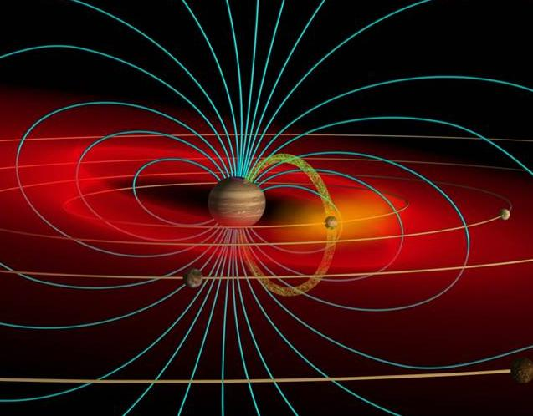
Motivation
Io’s atmosphere is strongly coupled with the Jovian plasma torus.
  Supplies gas to torus
  Bombarded by plasma
  The circum-Jovian environment can not be fully understood without understanding its main source (Io’s atmosphere)
Jupiter
Io
Plasma
Torus
Io Flux
Tube
Illustration by Dr. John Spencer
The dominant mechanism (volcanism or sublimation from SO₂ surface frosts) by which Io’s atmosphere is sustained is still unknown.
  Volcanism would be patchy and localized
  Sublimation-driven would be smoother and global
  The supply rate to the Jovian plasma torus is highly dependent on the relative contributions of these two mechanisms.
3

Slide 4
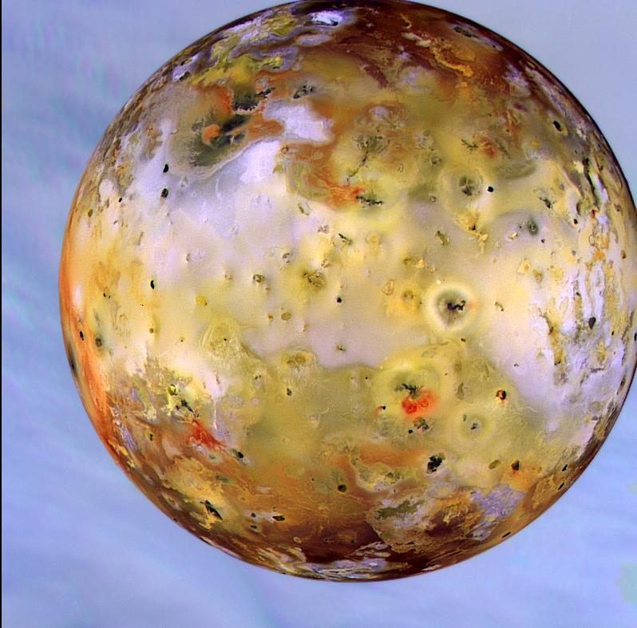
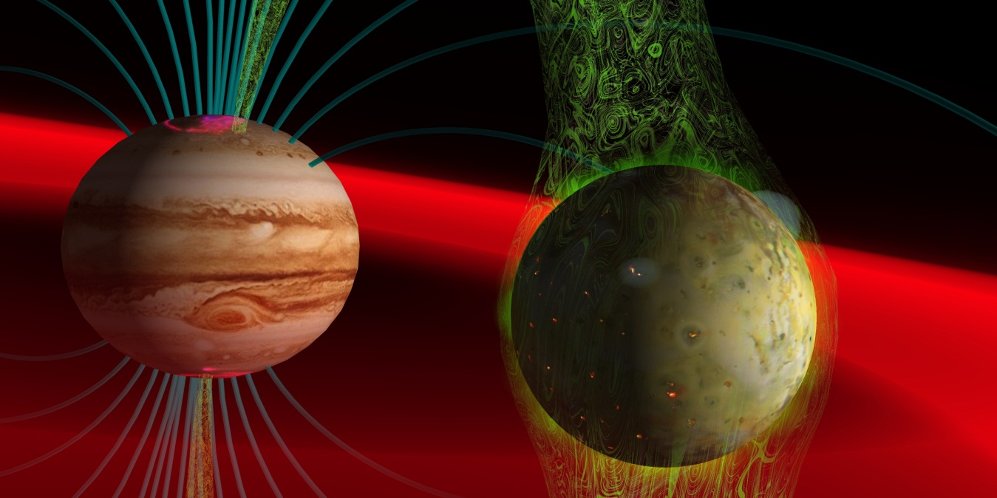
Background Information on Io
Frost patch of condensed SO₂
Jupiter
Io Flux
Tube
Io
Volcanic plume with ring deposition
Illustration by Dr. John Spencer
Io is the closest satellite to Jupiter
  Radius ≈ 1820 km (slightly larger than our moon)
  Atmosphere sustained by volcanism and sublimation from SO₂ surface frosts
  Dominant dayside atmospheric species is SO₂; lesser species - S, S₂, SO, O, O₂
Io is the most volcanically active body in the solar system
  Volcanism is due to an orbital resonance with Europa and Ganymede which causes strong tidal forces in Io’s solid
4

Slide 5
Overview of our DSMC code
Time scales
Chemistry picoseconds
Surface Sputtering nanoseconds
Plasma Timestep 0.005 seconds
Ion-Neutral Collsions 0.01 seconds - Hours
Vibrational Half-life millisecond-second
Cyclotron Gyration 0.5 seconds
Gas Timestep 0.5 seconds
Neutral Collisions 0.1 seconds - hours
Residence Time Seconds - Hours
Ballistic Time 2-3 Minutes
Flow Evolution 1-2 Hours
Eclipse 2 hours
Io hours simulated ~8 hours
SO₂ Photo Half-life 36 hours
Io Day 42 Hours
Three-dimensional
Parallel
Atmospheric models
  Rotational and vibrational energy states
  Sub-stepped emission
  Variable gravity
  Radial energy flux to model plasma bombardment
  Chemistry: neutral, photo, ion, & electron
Surface models
  Non-uniform SO₂ surface frosts
  Comprehensive surface thermal model
  Volcanic hot spots
  Residence time on the non-frost surface
  Surface sputtering by energetic ions
Numerical models
    Spatially and temporally varying weighting functions.
    Adaptive vertical grid that resolves mfp
    Sample onto to uniform output grid
    Separate plasma and neutral timesteps
5

Slide 6
3D / Parallel
3D
  Domain discretized by a spherical grid
Parallel
  MPI
  Tested up to 360 procesors
Parameters
  720 million molecules instantaneously
  Simulated ~1/6th of Io’s orbit
  ~120,000 computational hours
6

Slide 7
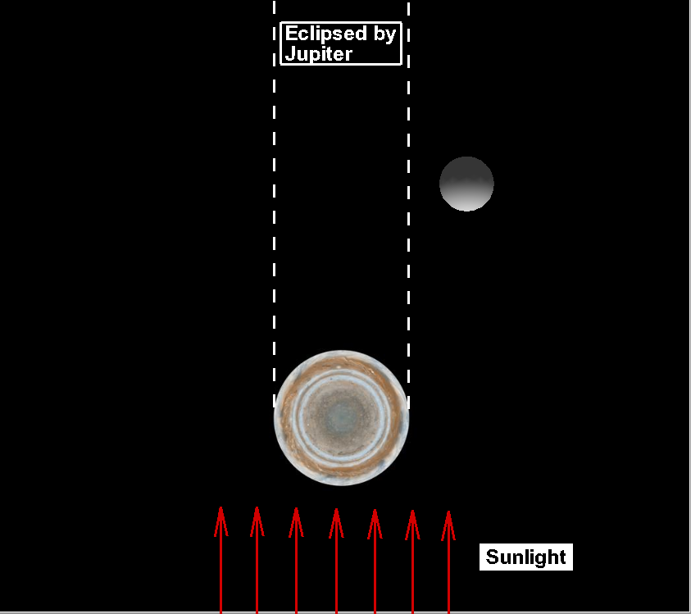

Orientation of Eclipse
Eclipsed
By
Jupiter
Nightside
Dayside
Sub-Jovian
Point
Subsolar
Point
Sunlight
Simulations begin ~2.5 hours before eclipse, extends through the 2 hour eclipse, and finishes ~3 hours after exit from eclipse
  The initial orientation is ~330 W and Io enter eclipse at ~351 W
  Io is tidally locked and therefore the sub-Jovian point (0 W) is fixed
  Consequently, only half of Io ever experiences eclipse
Note: Figure is not to scale.
7

Slide 8
Solid Surface Boundary Conditions
Frost Temperature
Non-Frost Temperature
Frost and non-frost surface temperature boundary conditions as a function of time near eclipse
  The SO₂ surface frost temperature drops ~10 K during the 2 hours of eclipse
  Due to exponential dependence, SO₂ column density drops ~10×
8

Slide 9
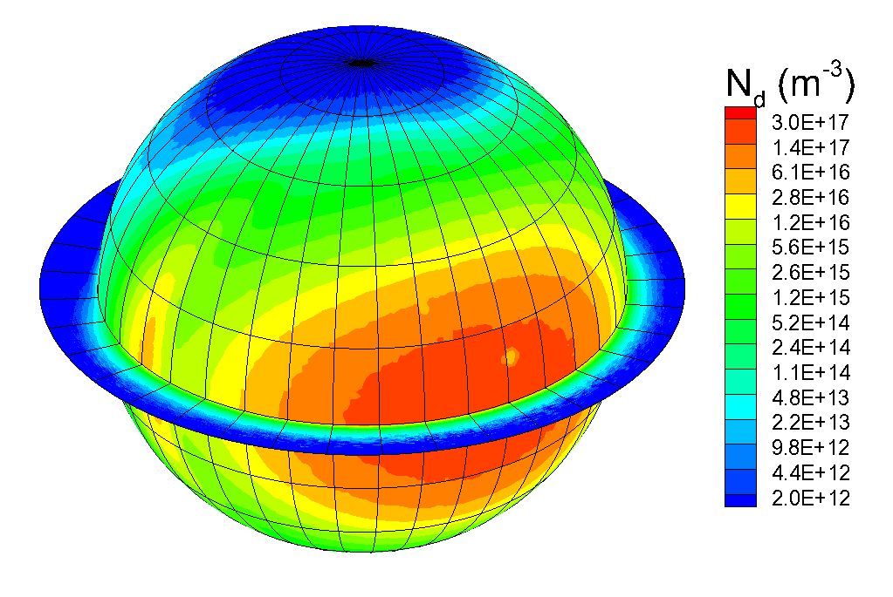
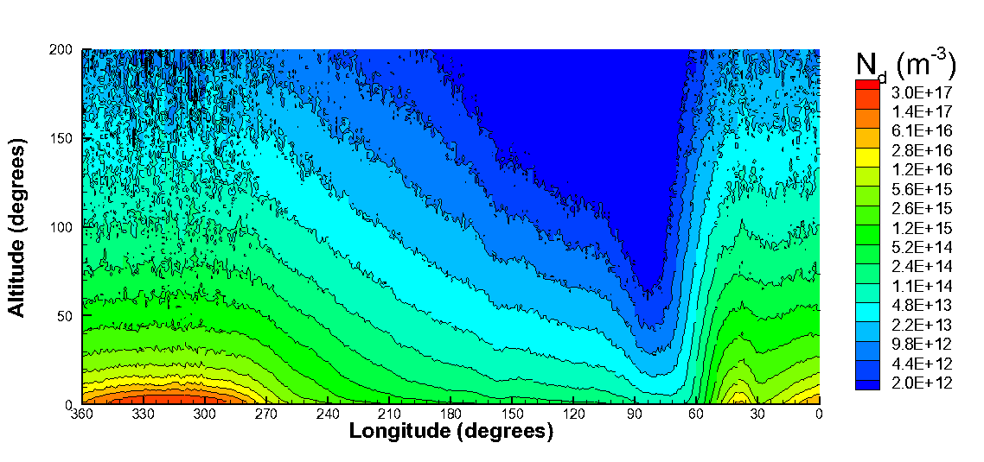
Equatorial Slice of Atmosphere
Atmosphere
in first cell above
the surface
Equatorial
Slice
“Unwrapped” Equatorial Slice
(Left) Actual geometry of equatorial slice.
(Right) “Rectangular/Unwrapped” geometry of equatorial slice.
9

Slide 10
Vertical Profile During Eclipse
Number Density
Translational Temperature
Atmosphere never reaches steady state during eclipse
  Dawn atmospheric enhancement appears just before eclipse, disappears during eclipse, and is further enlarged after eclipse
  Outside of eclipse, a high T_{TRANS} region exists at the dawn terminator due to circumplanetary flow creating a non-equilibrium region
10

Slide 11
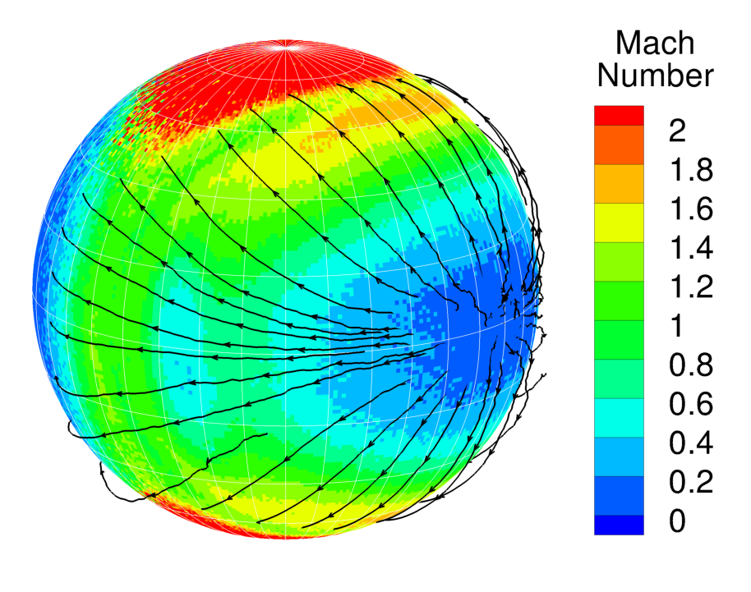
Global Winds
Pre-Eclipse
T = 0 s
Legend for
Subsolar Point
= Outside of Eclipse
= In Eclipse
Circumplanetary flow is forced from peak dayside pressure in all directions to the nightside
11

Slide 12
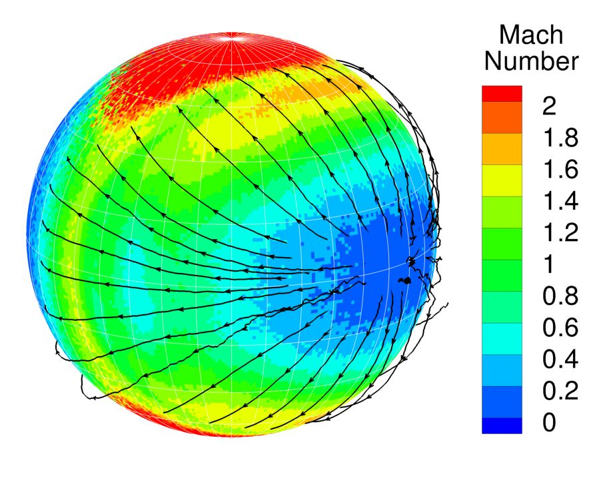
Global Winds
Pre-Eclipse
T = 1250 s
Legend for
Subsolar Point
= Outside of Eclipse
= In Eclipse
Flow is supersonic in a ellipse centered around the region of peak dayside pressure
12

Slide 13
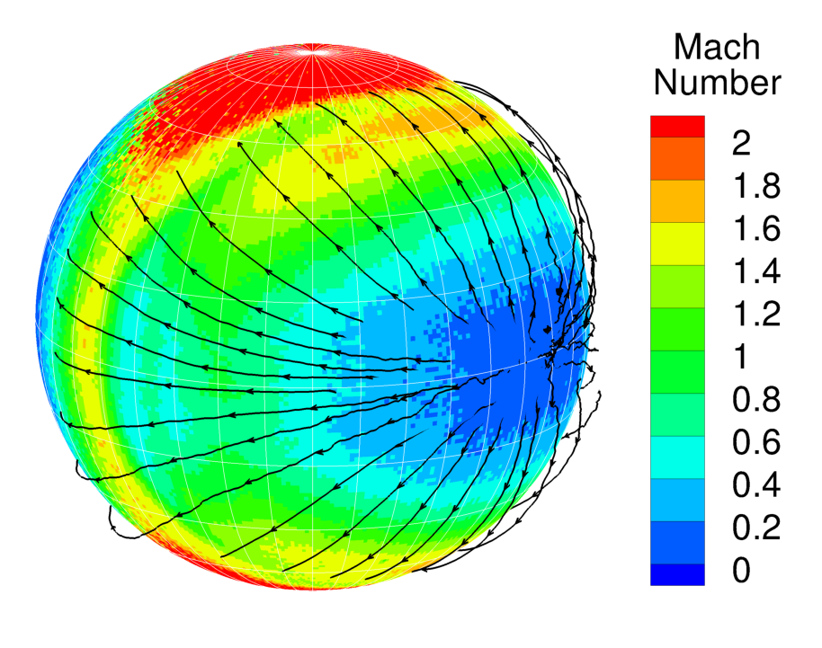
Global Winds
Pre-Eclipse
T = 2500 s
Legend for
Subsolar Point
= Outside of Eclipse
= In Eclipse
Ellipse is broken near the dawn terminator due to the enhancement of the atmosphere from molecules desorbing from the non-frost surface
13

Slide 14
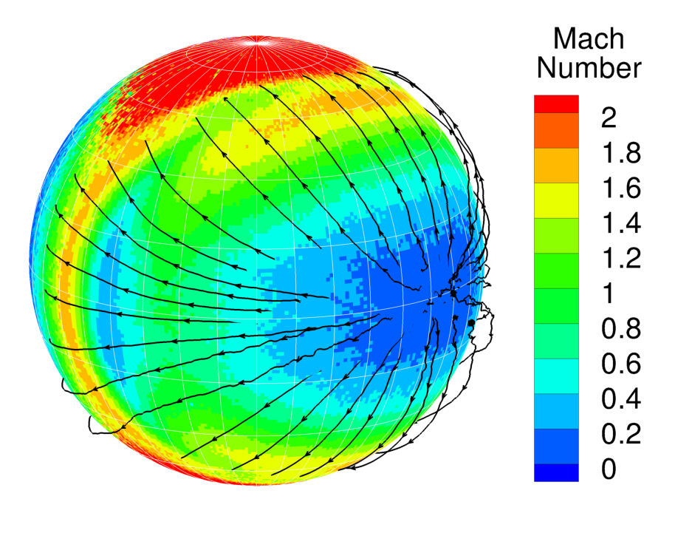
Global Winds
Pre-Eclipse
T = 3750 s
Legend for
Subsolar Point
= Outside of Eclipse
= In Eclipse
Dawn Atmospheric Enhancement grows just before entering eclipse and begins to deflect the flow
14

Slide 15
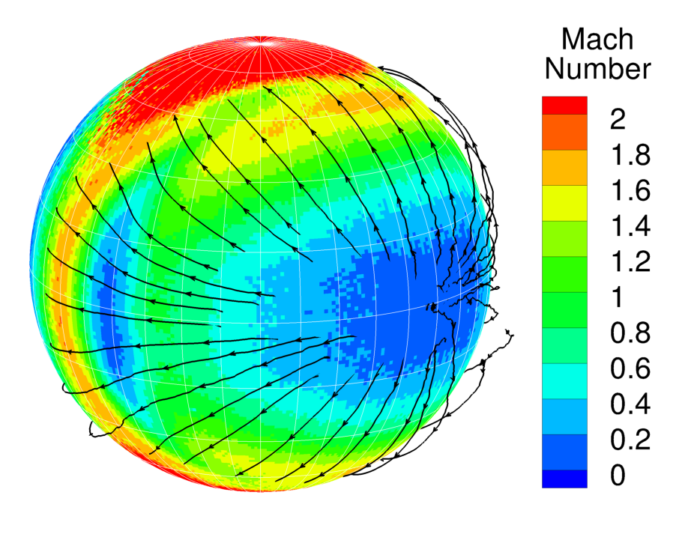
Global Winds
Pre-Eclipse
T = 5000 s
Legend for
Subsolar Point
= Outside of Eclipse
= In Eclipse
Notice the deflected streamlines to the left of the figure at mid-latitudes
15

Slide 16
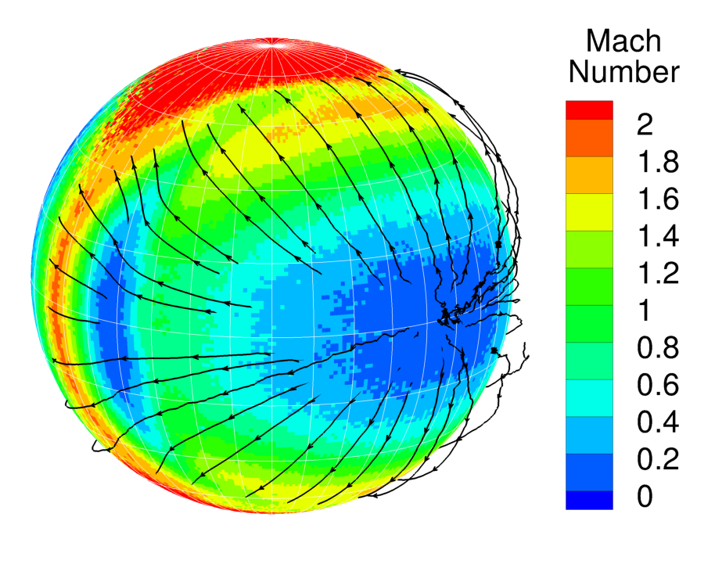
Global Winds
Pre-Eclipse
T = 6250 s
Legend for
Subsolar Point
= Outside of Eclipse
= In Eclipse
D.A.E. has grown large enough to completely block some flow while other flow is deflected up and over
16

Slide 17
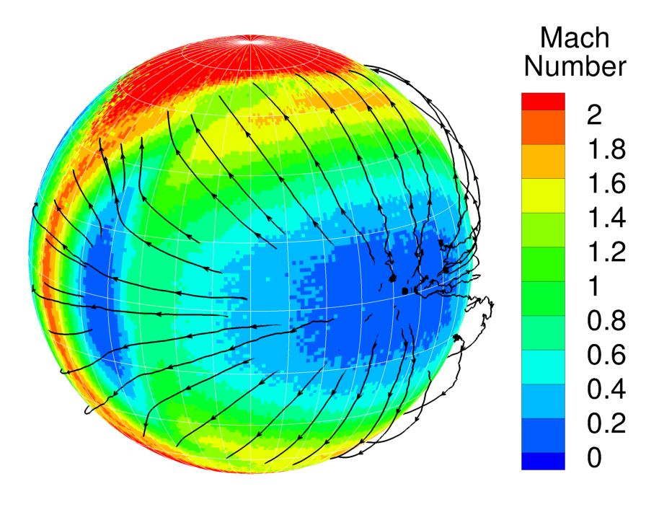
Global Winds
Pre-Eclipse
T = 7500 s
Legend for
Subsolar Point
= Outside of Eclipse
= In Eclipse
Peak dayside pressure still has expected structure with streamlines away in all directions
17

Slide 18
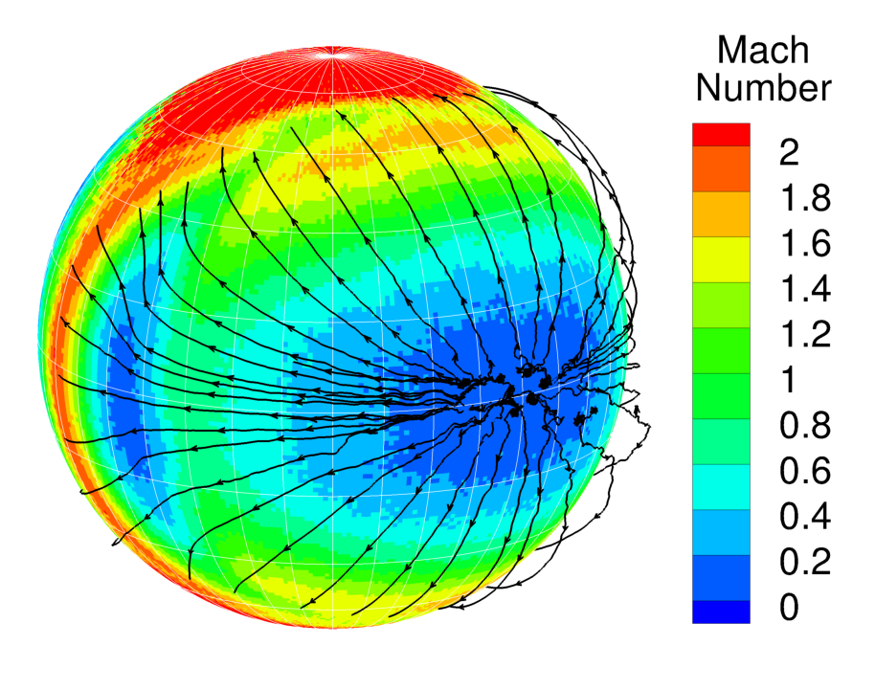
Global Winds
Pre-Eclipse
T = 8750 s
Legend for
Subsolar Point
= Outside of Eclipse
= In Eclipse
D.A.E. strongly deflects streamlines at the left of the figure
18

Slide 19
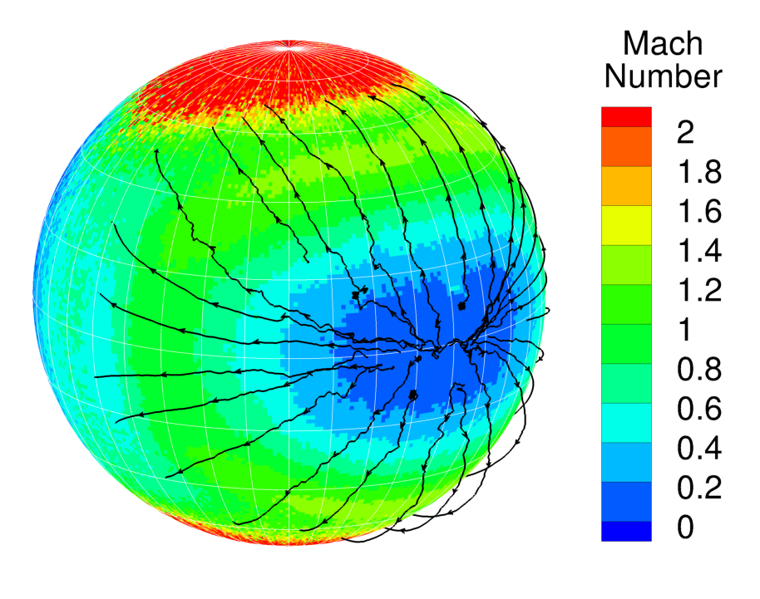
Global Winds
In Eclipse
T = 10000 s
Legend for
Subsolar Point
= Outside of Eclipse
= In Eclipse
The atmosphere collapses in eclipse and therefore the pressure gradient is reduced
19

Slide 20
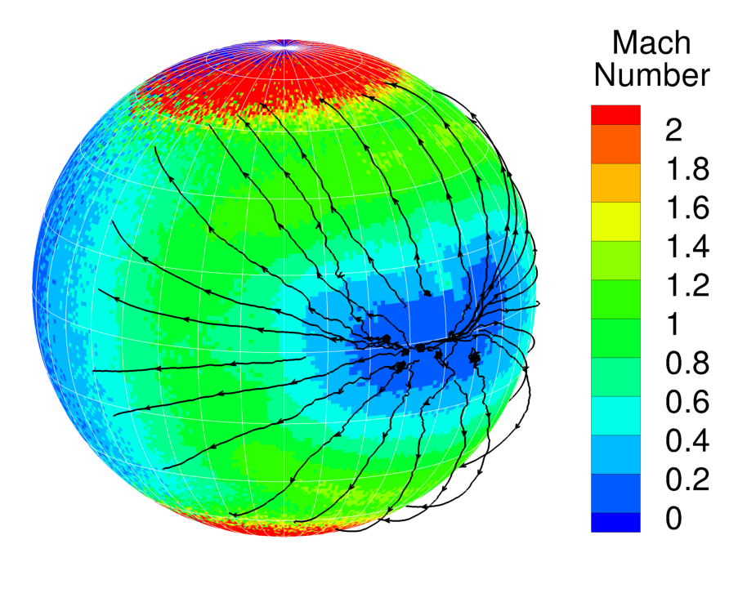
Global Winds
In Eclipse
T = 11250 s
Legend for
Subsolar Point
= Outside of Eclipse
= In Eclipse
During 2 hour eclipse, the pressure drops by ~20x
20

Slide 21
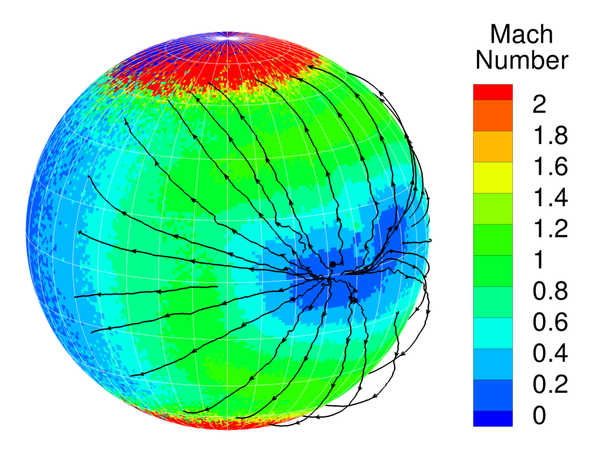
Global Winds
In Eclipse
T = 12500 s
Legend for
Subsolar Point
= Outside of Eclipse
= In Eclipse
D.A.E. disappears in eclipse and only the large peak dayside region with flow away in all directions remains
21

Slide 22
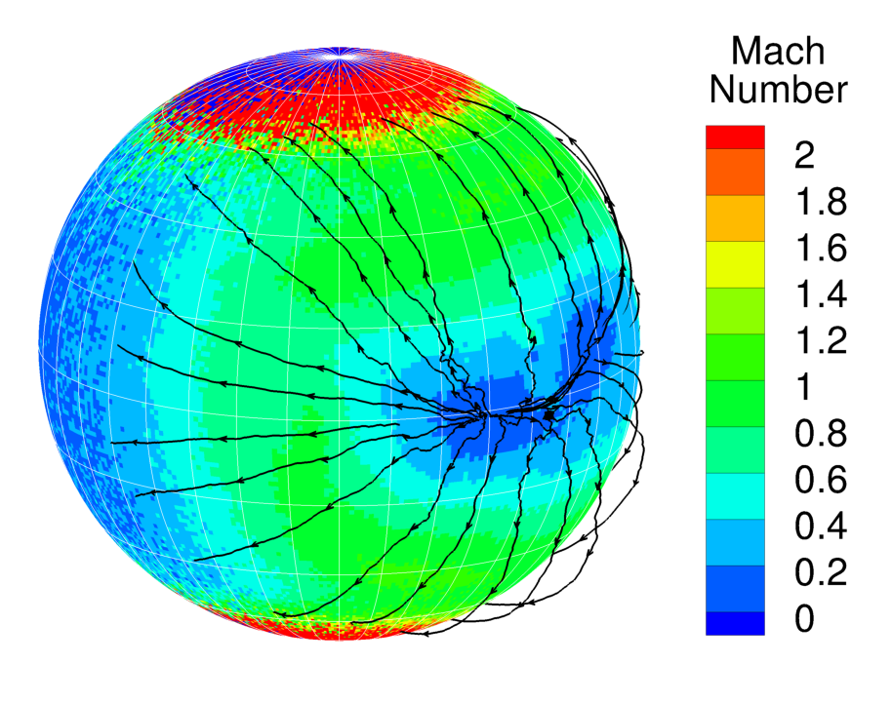
Global Winds
In Eclipse
T = 13750 s
Legend for
Subsolar Point
= Outside of Eclipse
= In Eclipse
Region of peak dayside pressure counter-rotates due to the thermal wave with depth into the surface
22

Slide 23

Global Winds
In Eclipse
T = 15000 s
Legend for
Subsolar Point
= Outside of Eclipse
= In Eclipse
Peak dayside region begins to split in two with two distinct sources for the flow
23

Slide 24
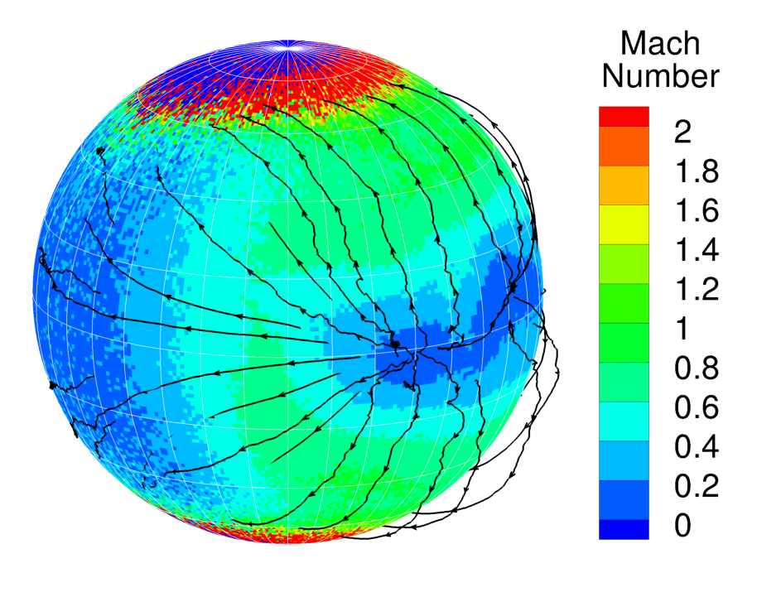
Global Winds
In Eclipse
T = 16250 s
Legend for
Subsolar Point
= Outside of Eclipse
= In Eclipse
Flow near the end of eclipse is very weak (all subsonic).
24

Slide 25
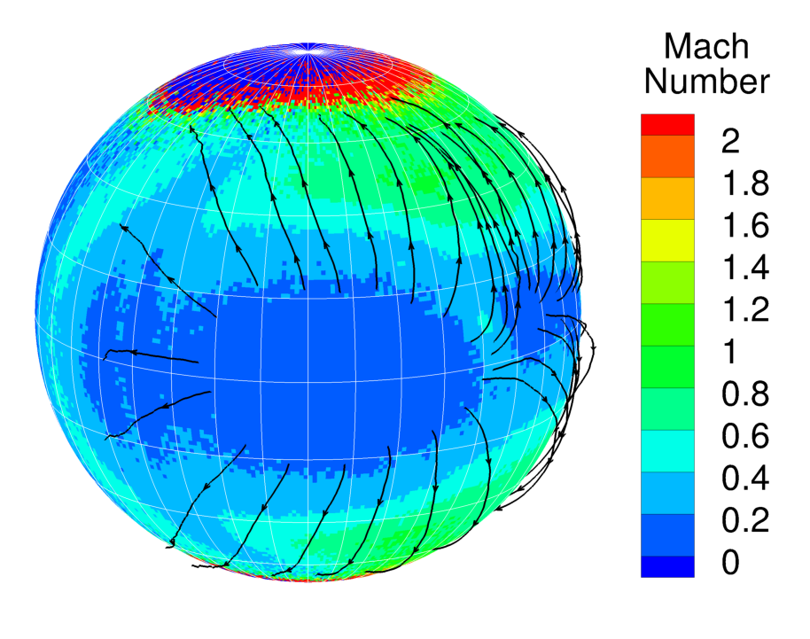
Global Winds
Post-Eclipse
T = 17500 s
Legend for
Subsolar Point
= Outside of Eclipse
= In Eclipse
Drastic change in to the Mach number contours post-eclipse. Peak dayside pressure rapidly equilibrates and actually overshoots normal thermal lag location.
25

Slide 26
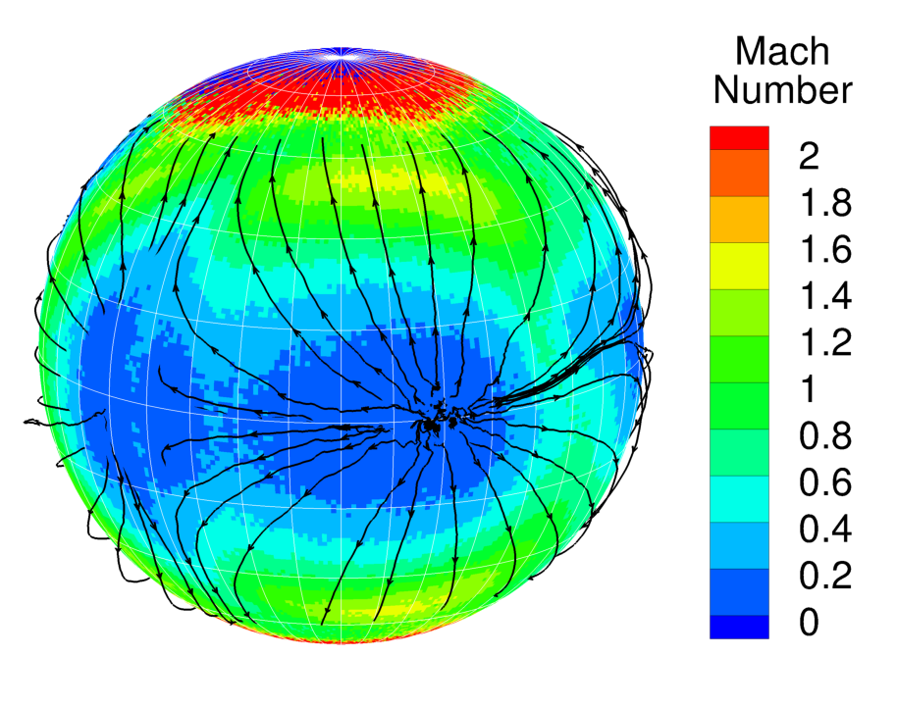
Global Winds
Post-Eclipse
T = 18750 s
Legend for
Subsolar Point
= Outside of Eclipse
= In Eclipse
D.A.E. expands again and now rivals peak dayside pressure region. Atmosphere begins to form stagnation point flow.
26

Slide 27
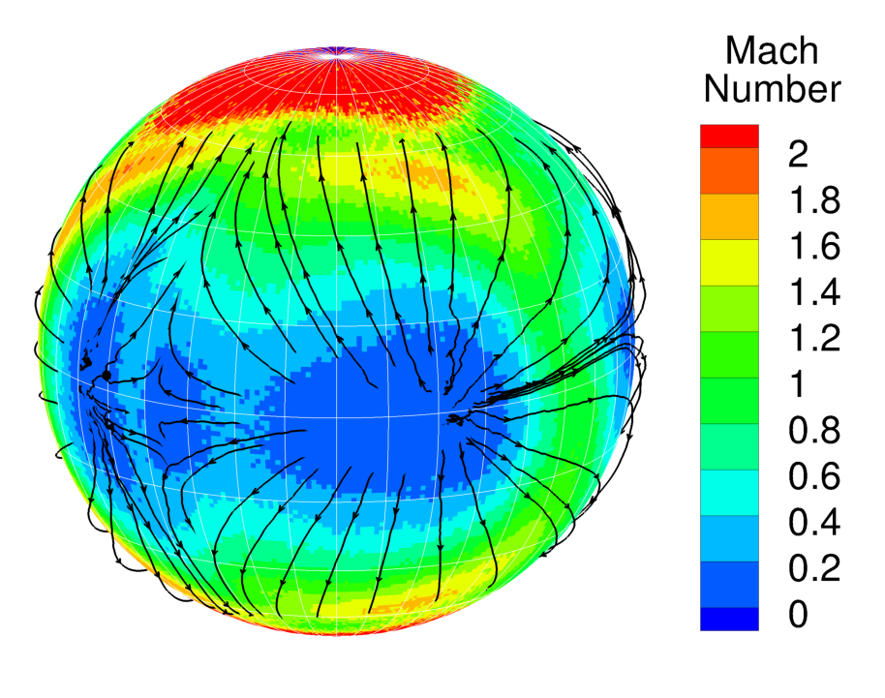
Global Winds
Post-Eclipse
T = 20000 s
Legend for
Subsolar Point
= Outside of Eclipse
= In Eclipse
Clear stagnation point flow between the D.A.E. and the region of peak dayside pressure.
27

Slide 28
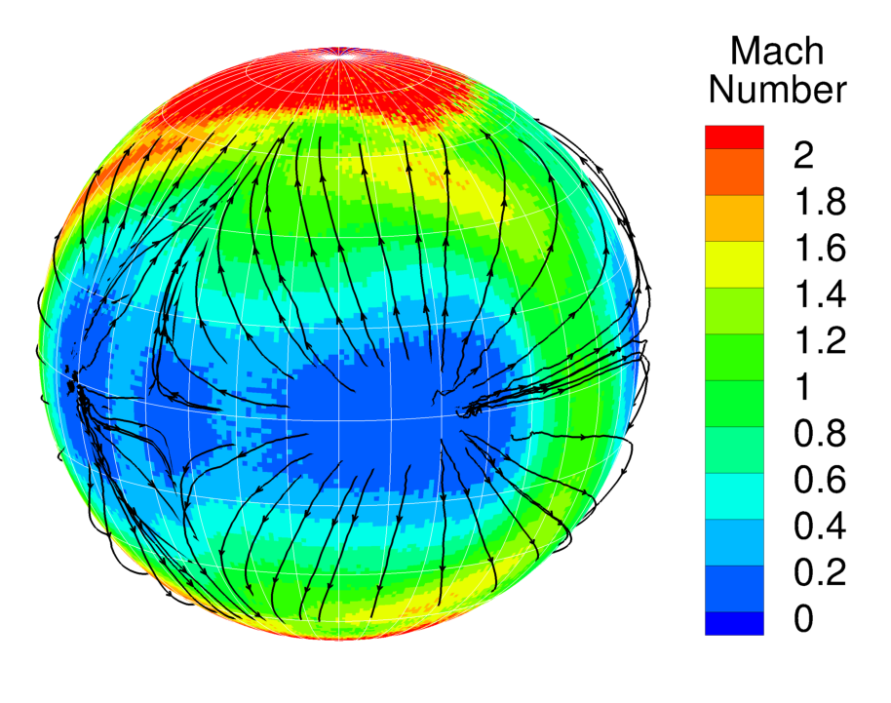
Global Winds
Post-Eclipse
T = 21250 s
Legend for
Subsolar Point
= Outside of Eclipse
= In Eclipse
Stagnation point flow is sustained and flow near terminator is once again supersonic.
28

Slide 29
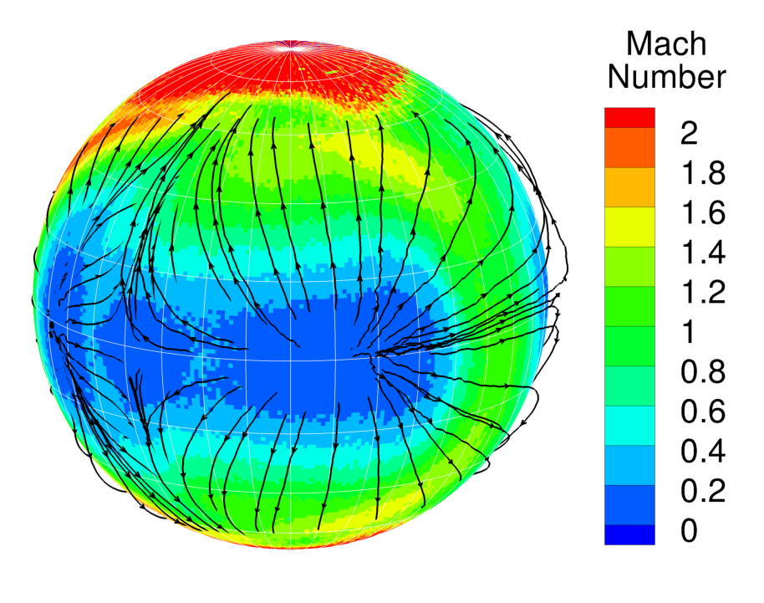
Global Winds
Post-Eclipse
T = 22500 s
Legend for
Subsolar Point
= Outside of Eclipse
= In Eclipse
This flow structure is maintained for the rest of the animation.
29

Slide 30
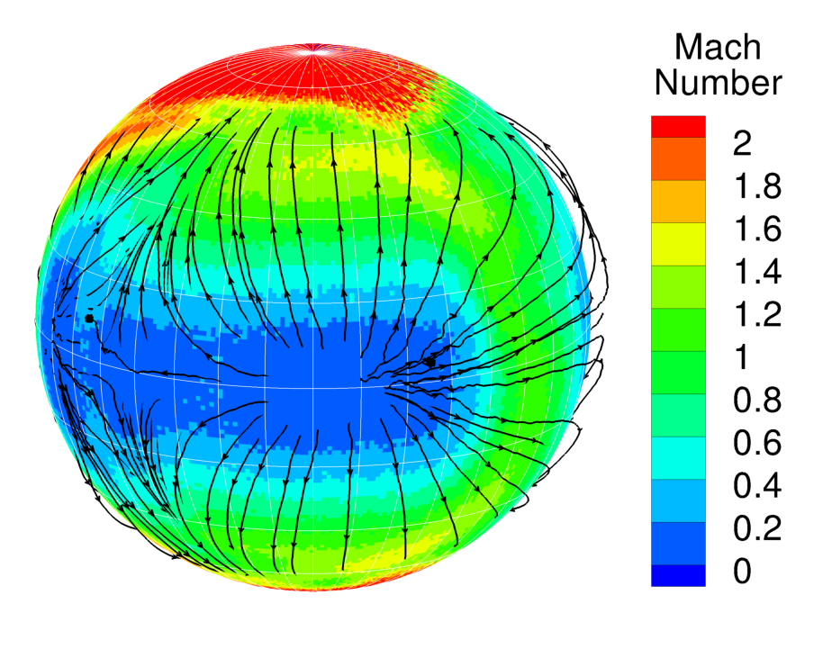
Global Winds
Post-Eclipse
T = 23750 s
Legend for
Subsolar Point
= Outside of Eclipse
= In Eclipse
This flow structure is maintained for the rest of the animation.
30

Slide 31
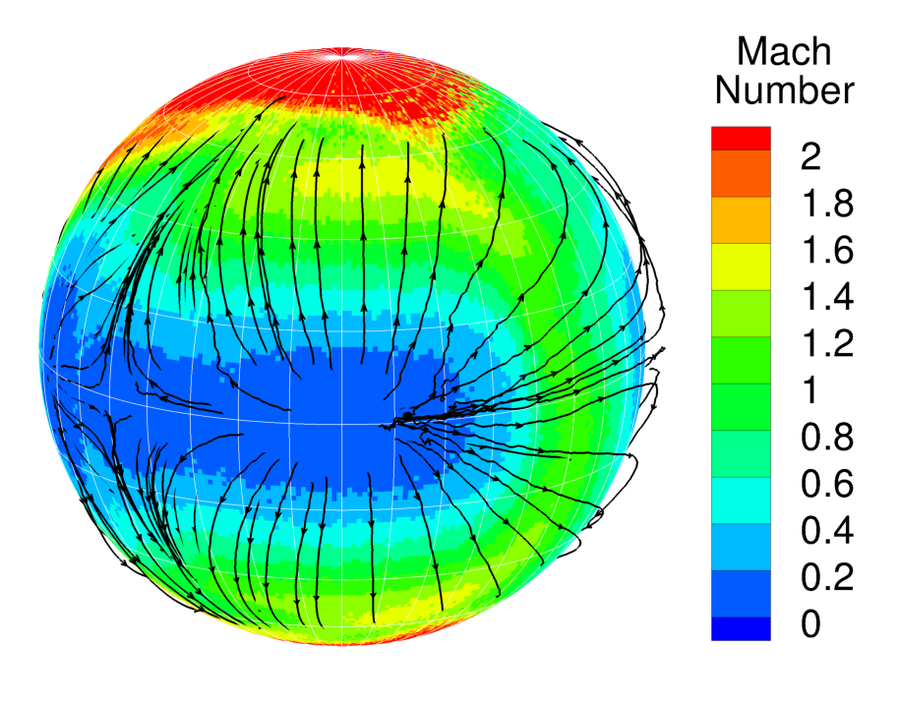
Global Winds
Post-Eclipse
T = 25000 s
Legend for
Subsolar Point
= Outside of Eclipse
= In Eclipse
This flow structure is maintained for the rest of the animation.
31

Slide 32
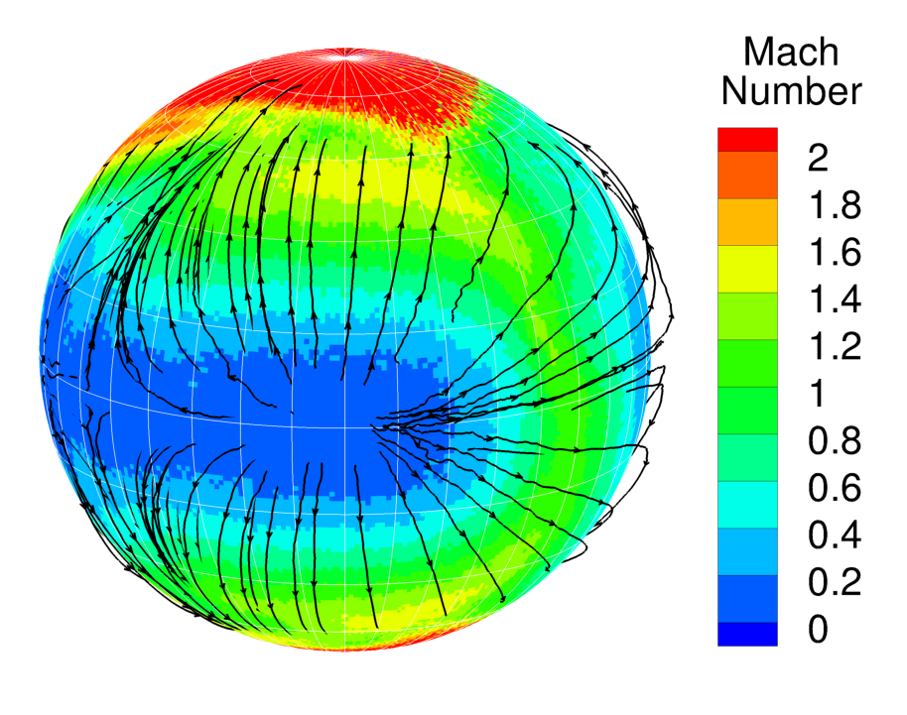
Global Winds
Post-Eclipse
T = 26250 s
Legend for
Subsolar Point
= Outside of Eclipse
= In Eclipse
This flow structure is maintained for the rest of the animation.
32

Slide 33
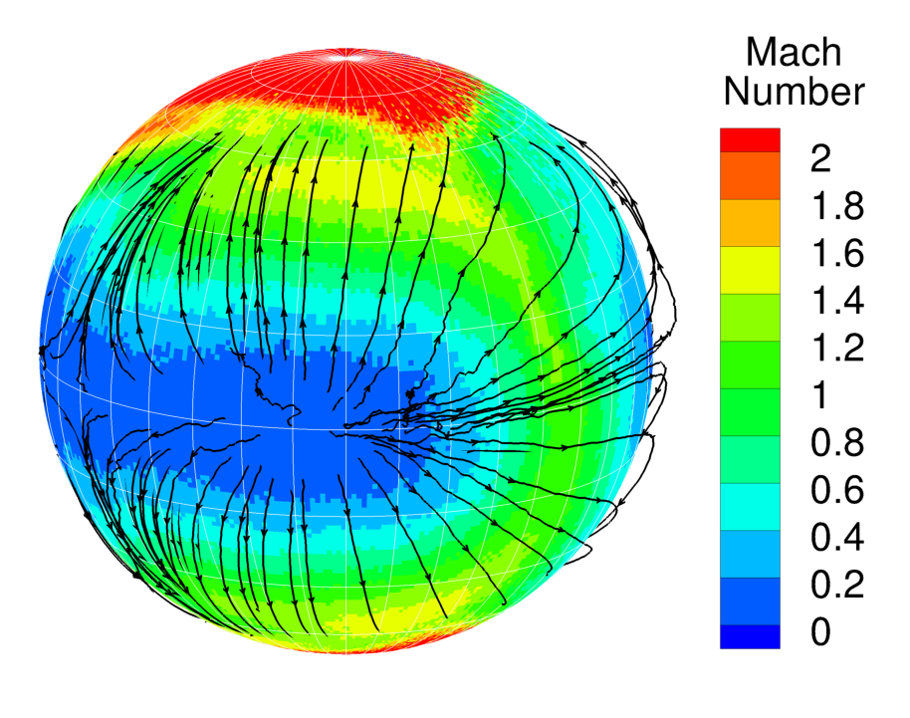
Global Winds
Post-Eclipse
T = 27500 s
Legend for
Subsolar Point
= Outside of Eclipse
= In Eclipse
This flow structure is maintained for the rest of the animation.
33

Slide 34
Conclusions
Io’s atmosphere is highly unsteady during eclipse by Jupiter
  A quasi-steady state is never reached during eclipse
The surface temperature has substantial deviations from the quasi-steady state that exists outside eclipse
  SO₂ surface frost temperatures fall by ~10 K resulting in ~20x drop in SO₂ column density
  Non-frost surface temperatures fall by ~50 K resulting in a large build-up of SO₂ on the surface during eclipse
Eclipse causes complex flow patterns before, during, and after eclipse
  Before eclipse, an atmospheric enhancement near dawn leads to deflected streamlines at mid-latitudes
  During eclipse, peak flow speeds become subsonic
  After eclipse, the atmospheric enhacement near dawn is enlarged due to the partial collapse of the atmosphere and this leads to stagnation point flow
34

