Slide 1

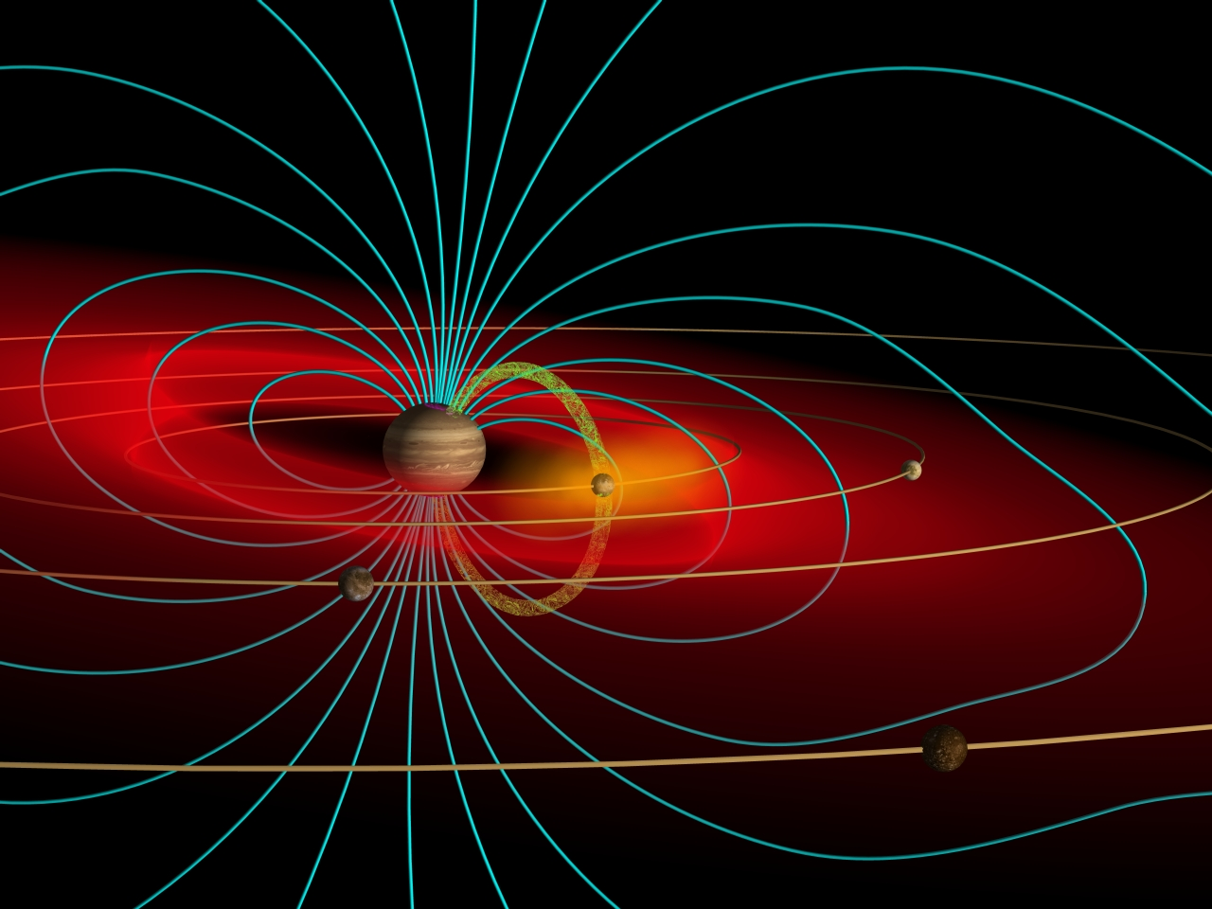
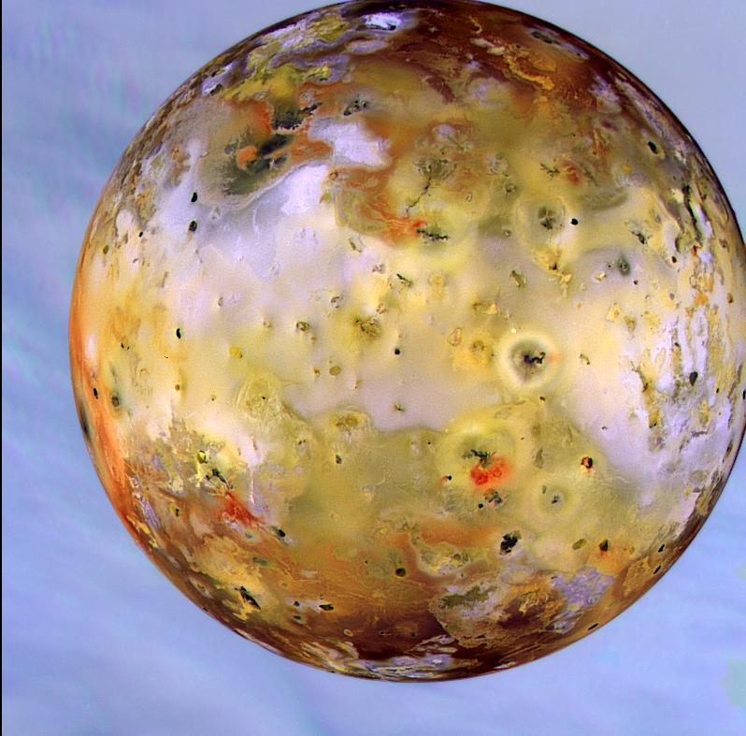
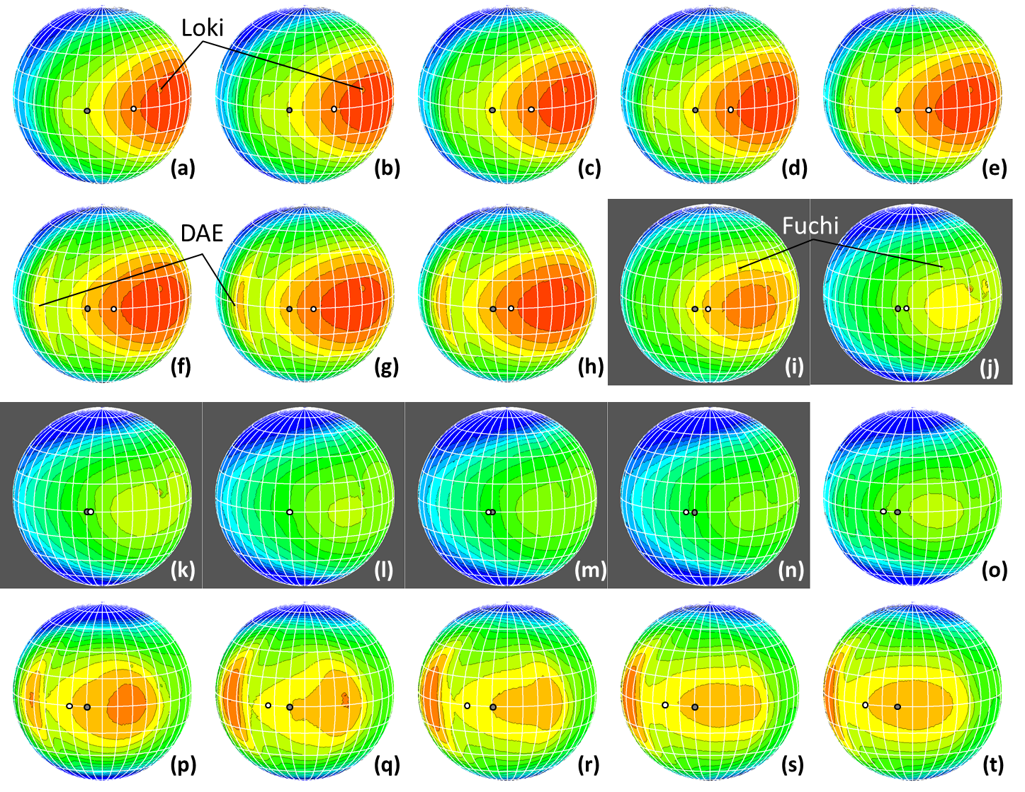
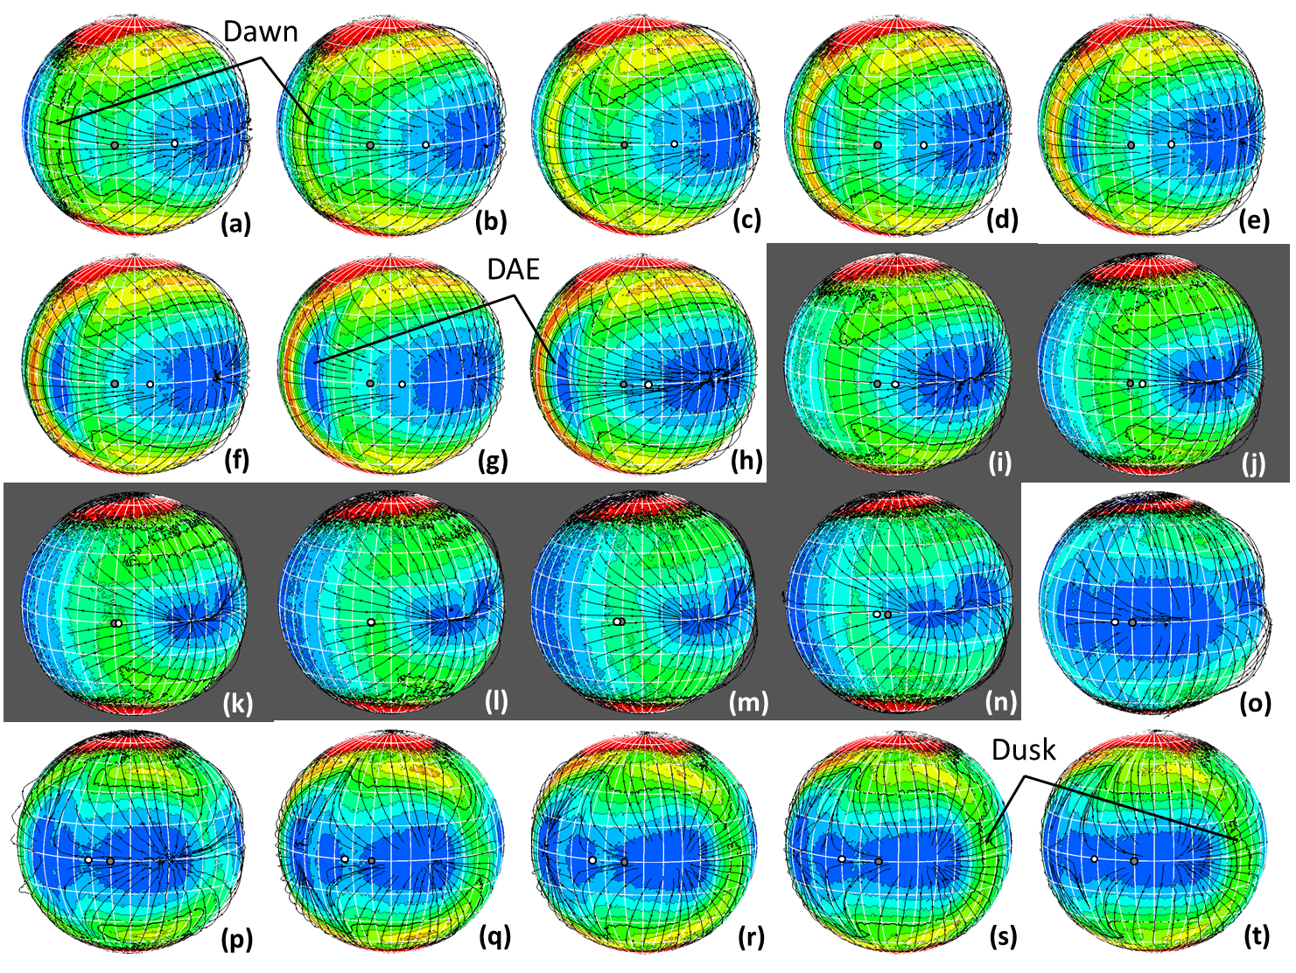
A Parametric Study of Io’s Thermophysical Surface Properties and Subsequent Numerical Atmospheric Simulations Based on the Best Fit Parameters
Walker, A.C. †, Moore, C.H. §, Goldstein, D.B. †, Varghese, P.L. †, Trafton, L.M. ‡
The University of Texas at Austin, †Department of Aerospace Engineering, ‡Department of Astronomy
§Sandia National Laboratories
Io is the closest Galilean satellite of Jupiter and the most volcanically active body in the solar system. The relative contributions of sublimation, volcanism, and sputtering to Io’s rarefied atmosphere remain poorly understood.
The SO₂ surface frosts have a high thermal inertia leading to a ~5 K drop in T_{F} during eclipse; however, this corresponds to a factor of 20 decrease in column density due to the exponential dependence of the SO₂ vapor pressure on T_{F}. The thermal model predicts a prograde rotation of the atmosphere during eclipse (as opposed to the retrograde rotation that exists outside of eclipse) due to the differing amounts of insolation absorbed by the surface due to eclipse.
Figure 1 – (left) Α depiction of the Jovian system including the Jovian plasma torus, Io, and Jupiter’s magnetic field lines (Illustration by John Spencer). (right) An enhanced color image of Io’s surface showing patches of condensed SO₂ frost and ring deposits from volcanic plumes.
Parametric Study of Thermophysical Properties
A parametric study was performed to constrain the thermophysical properties of Io’s surface. The thermal model solves the heat conduction equation including the effects of thermal inertia, latent heats of sublimation and condensation, eclipse by Jupiter, and radiation from Jupiter for two separate surface components: SO₂ frosts and non-frost (likely pyroclastic dusts and/or sulfur allotropes).
The resulting SO₂ surface frost temperature distribution was compared to the inferred frost temperatures of Jessup et al. (2004) and the resulting non-frost temperature distribution was compared to Galileo PPR observations (Rathbun et al., 2004). The best fit thermophysical parameters were found to be α_{F} ≈ 0.55 and Γ_{F} ≈ 200 J m^{‒2} K^{‒1} s^{‒1/2} for the SO₂ surface frost and α_{NF} ≈ 0.49 and Γ_{NF} ≈ 20 J m^{‒2} K^{‒1} s^{‒1/2} for the non-frost.
Figure 4 – Column density contours with the view centered at (10° N, 350° W) as a function of time. The 20 snapshots occur at intervals of 1250 seconds (~21 minutes) starting approximately 2 hours and 40 minutes prior to eclipse and ending ~2 hours after egress from eclipse. The white dots denotes the location of the subsolar point while the black dots denotes the location of the sub-Jovian point. Loki is the largest hot spot on Io, Fuchi is another large hot spot, and DAE denotes the dawn atmospheric enhancement.
Supersonic circumplanetary flow exists prior to eclipse but becomes subsonic during eclipse because the day-to-night pressure gradient weakens considerably as the surface cools and atmosphere condenses. Before eclipse, an oblique shock exists near the dawn terminator where the supersonic flow condenses on and near the cold nightside. During eclipse, the oblique shock disappears as the day-to-night pressure gradient weakens.
Figure 2 – (left) χ² (least squared error) as a function of frost albedo, α_{F}, and thermal inertia, Γ_{F}. (right) A comparison between observed (Rathbun et al., 2004) and simulated equatorial brightness temperatures.
Global Atmospheric Simulations of Io in Eclipse
After constraining the thermophysical parameters, they were used to generate the solid surface boundary condition in DSMC atmospheric simulations. The atmospheric simulations focused on the effect of eclipse on the atmospheric winds, temperatures, and densities. Results presented span approximately 6 hours of Io’s 42 hour orbit with eclipse occurring near the middle of the simulated time.
Figure 5 – Mach number contours overlaid with streamlines with the same view and time interval as Figure 4.
REFERENCES:
Jessup, K.L., Spencer, J.R., Ballester, G.E., Howell, R.R., Roesler, F., Vigel, M., Yelle, R., 2004. Icarus 169, 197-215.
Rathbun, J.A., Spencer, J.R., Tamppari, L.K., Martin, T.Z., Barnard, L., Travis, L.D., 2004. Icarus 169, 127-139.
Figure 3 – Contours of number density and translational temperature for a slice through the equator at selected times through eclipse.

