Slide 1

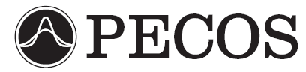
Application of Bayesian Statistical Methods for the Analysis of DSMC Simulations of Hypersonic Shocks
James S. Strand and David B. Goldstein
The University of Texas at Austin
Sponsored by the Department of Energy through the PSAAP Program
Predictive Engineering and Computational Sciences
Computational Fluid Physics Laboratory

Slide 2
Motivation – DSMC Parameters
The DSMC model includes many parameters related to gas dynamics at the molecular level, such as:
  Elastic collision cross-sections.
  Vibrational and rotational excitation probabilities.
  Reaction cross-sections.
  Sticking coefficients and catalytic efficiencies for gas-surface interactions.
  …etc.

Slide 3
DSMC Parameters
In many cases the precise values of some of these parameters are not known.
Parameter values often cannot be directly measured, instead they must be inferred from experimental results.
By necessity, parameters must often be used in regimes far from where their values were determined.
More precise values for important parameters would lead to better simulation of the physics, and thus to better predictive capability for the DSMC method. The ultimate goal of this work is to use experimental data to calibrate important DSMC parameters.

Slide 4
DSMC Method
Direct Simulation Monte Carlo (DSMC) is a particle based simulation method.
Simulated particles represent large numbers of real particles.
Particles move and undergo collisions with other particles.
Can be used in highly non-equilibrium flowfields (such as strong shock waves).
Can model thermochemistry on a more detailed level than most CFD codes.

Slide 5
DSMC Method
Performed on
First Time Step
Initialize
Create
Move
Performed on
Every Time Step
Index
Collide
Sample
Performed on
Selected Time Steps

Slide 6
Numerical Methods – DSMC Code
Our DSMC code can model flows with rotational and vibrational excitation and relaxation, as well as five-species air chemistry, including dissociation, exchange, and recombination reactions.
Larsen-Borgnakke model is used for redistribution between rotational, translational, and vibrational modes during inelastic collisions.
TCE model provides cross-sections for chemical reactions.

Slide 7
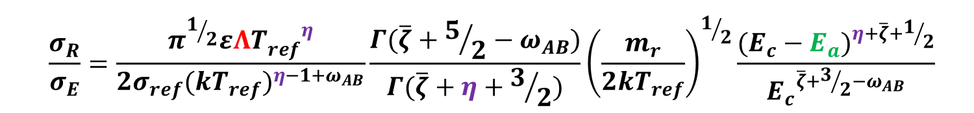

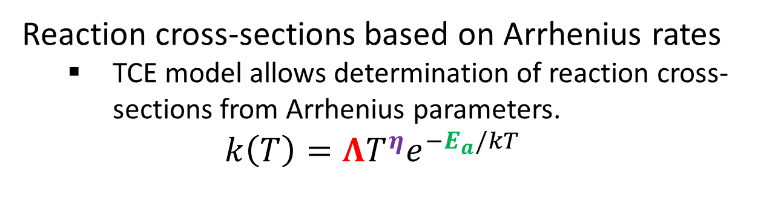
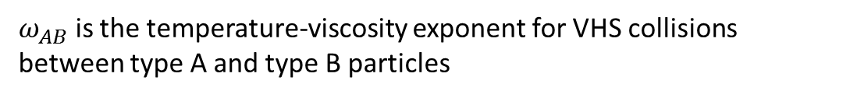
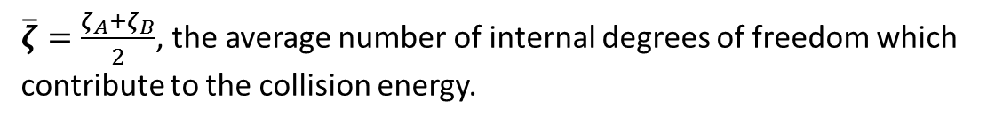
Chemistry Implementation
Reaction cross-sections based on Arrhenius rates
  TCE model allows determination of reaction cross-sections from Arrhenius parameters.
  $$k\left(T\right)=ΛT^{η}e^{−E_{a}/kT}$$
  $$\frac{σ_{R}}{σ_{E}}=\frac{π^{1/2}εΛ{T_{ref}^{}}^{η}}{2σ_{ref}{(kT_{ref})}^{η−1+ω_{AB}}}\frac{Γ(\overline{ζ}+5/2−ω_{AB})}{Γ(\overline{ζ}+η+3/2)}{\left(\frac{m_{r}}{2kT_{ref}}\right)}^{1/2}\frac{{(E_{c}−E_{a})}^{η+\overline{ζ}+1/2}}{{E_{c}}^{\overline{ζ}+3/2−ω_{AB}}}$$
σ_{R} and σ_{E} are the reaction and elastic cross-sections, respectively
$\overline{ζ}=\frac{ζ_{A}+ζ_{B}}{2}$, the average number of internal degrees of freedom which
contribute to the collision energy.
$$ε=1 \left(if A≠B\right)or 2 \left(if A=B\right)$$
$$σ_{ref} and T_{ref} are both constants related to the VHS collision model$$
$ω_{AB}$ is the temperature-viscosity exponent for VHS collisions between type A and type B particles
k is the Boltzmann constant, m_{r} is the reduced mass of particles A and B, E_{c} is the collision energy, and Γ() is the gamma function.

Slide 8

Reactions
$$k\left(T\right)=ΛT^{η}e^{−E_{a}/kT}$$
R. Gupta, J. Yos, and R. Thompson, NASA Technical Memorandum 101528, 1989.

Slide 9
1D Shock Simulation
We require the ability to simulate a 1-D shock without knowing the post-shock conditions a priori.
To this end, we simulate an unsteady 1-D shock, and make use of a sampling region which moves with the shock.

Slide 10
Sensitivity Analysis - Overview
In the current context, the goal of sensitivity analysis is to determine which parameters most strongly affect a given quantity of interest (QoI).
Only parameters to which a given QoI is sensitive will be informed by calibrations based on data for that QoI.
Sensitivity analysis is used here both to determine which parameters to calibrate in the future, and to select the QoI which would best inform the parameters we most wish to calibrate.

Slide 11


Sensitivity Analysis Parameters
$$k\left(T\right)=ΛT^{η}e^{−E_{a}/kT}$$
$${10}^{α}=Λ$$
Throughout the sensitivity analysis, the ratio of forward to backward rate for a given
reaction is kept constant, since these ratios should be fixed by the equilibrium constant.

Slide 12
Scenario: 1-D Shock
Shock speed is ~8000 m/s, M∞ ≈ 23.
  Upstream number density = 3.22×10²¹ #/m³.
  Upstream composition by volume: 79% N₂, 21% O₂.
  Upstream temperature = 300 K.

Slide 13
Results: Nominal Parameter Values

Slide 14
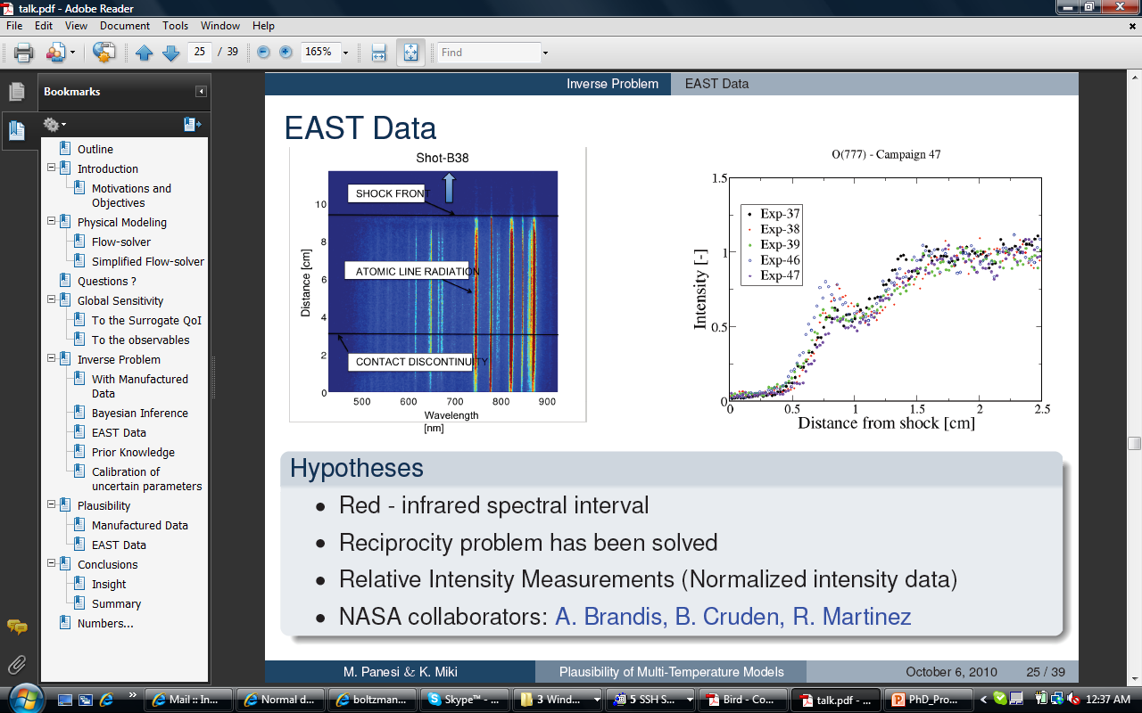
Quantity of Interest (QoI)
We cannot yet simulate EAST
results, so we must choose a
temporary, surrogate QoI.
?
J. Grinstead, M. Wilder, J. Olejniczak, D. Bogdanoff, G. Allen, and K. Danf, AIAA Paper 2008-1244, 2008.

Slide 15
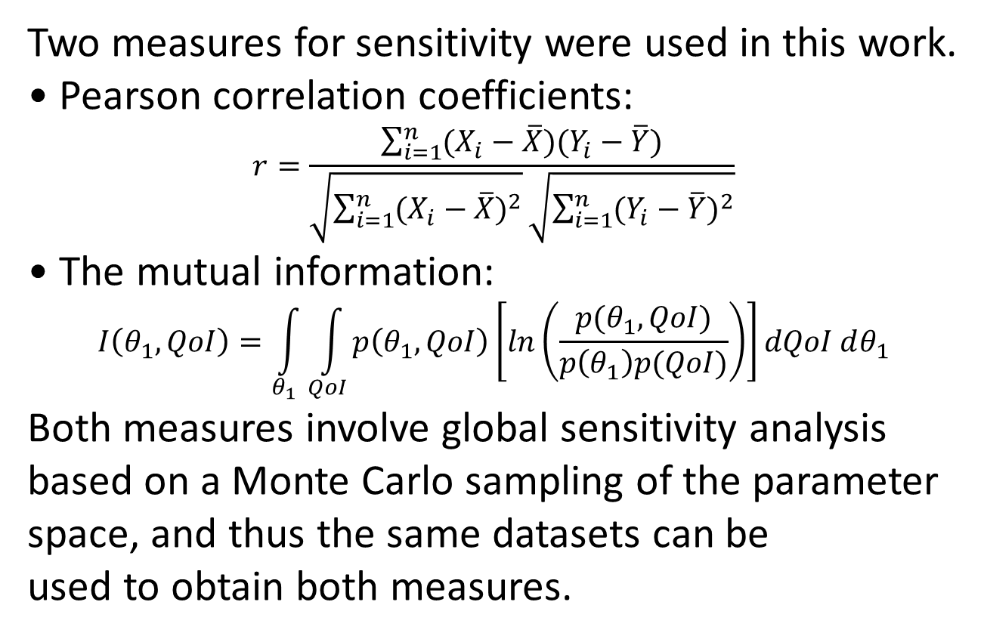
Sensitivity Analysis - Methods
Two measures for sensitivity were used in this work.
Pearson correlation coefficients:
$$r=\frac{\sum_{i=1}^{n}{(X_{i}−\overline{X})(Y_{i}−\overline{Y})}}{\sqrt{\sum_{i=1}^{n}{{(X_{i}−\overline{X})}^{2}}}\sqrt{\sum_{i=1}^{n}{{(Y_{i}−\overline{Y})}^{2}}}}$$
The mutual information:
$$I\left(θ_{1},QoI\right)=\int_{θ_{1}}^{ }{\int_{QoI}^{ }{p\left(θ_{1},QoI\right)\left[ln\left(\frac{p(θ_{1},QoI)}{p\left(θ_{1}\right)p(QoI)}\right)\right]}}dQoI dθ_{1}$$
Both measures involve global sensitivity analysis based on a Monte Carlo sampling of the parameter space, and thus the same datasets can be
used to obtain both measures.

Slide 16
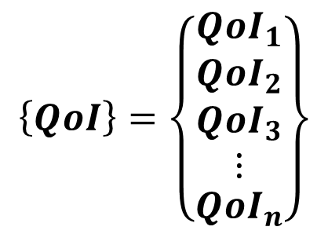
Sensitivity Analysis - Scalar vs. Vector QoI
We use two QoI’s in this work, the bulk translational temperature and the density of NO. Each of these is a vector QoI, with values over a range of points in space.
$$\left\{QoI\right\}=\left\{\begin{matrix}{QoI}_{1} \\ \begin{matrix}{QoI}_{2} \\ \begin{matrix}{QoI}_{3} \\ ⋮\end{matrix}\end{matrix} \\ {QoI}_{n}\end{matrix}\right\}$$

Slide 17
Sensitivity Analysis: Correlation Coefficient

Slide 18
Sensitivity Analysis: Mutual Information

Slide 19
Sensitivity Analysis: Mutual Information

Slide 20
Sensitivity Analysis: Mutual Information

Slide 21

Sensitivity Analysis: Mutual Information
Actual joint PDF
of θ₁ and the
QoI, from a
Monte Carlo
sampling of the
parameter space.
QoI
Kullback-Leibler divergence
$$p\left(θ_{1},QoI\right)\left[ln\left(\frac{p(θ_{1},QoI)}{p\left(θ_{1}\right)p(QoI)}\right)\right]$$
Hypothetical joint
PDF for case
where the QoI is
indepenent of θ₁.
θ₁
$$I\left(θ_{1},QoI\right)=\int_{θ_{1}}^{ }{\int_{QoI}^{ }{p\left(θ_{1},QoI\right)\left[ln\left(\frac{p(θ_{1},QoI)}{p\left(θ_{1}\right)p(QoI)}\right)\right]}}dQoI dθ_{1}$$

Slide 22
Sensitivities vs. X for T_{trans,bulk} as QoI

Slide 23
Sensitivities vs. X for ρ_{NO} as QoI

Slide 24
r² vs. Mutual Information

Slide 25
Sensitivities vs. X for ρ_{NO} as QoI

Slide 26
Variance of ρ_{NO} vs. X

Slide 27
Variance Weighted Sensitivities for ρ_{NO} as QoI

Slide 28
Overall Sensitivities

Slide 29
Conclusions
Global, Monte Carlo based sensitivity analysis can provide a great deal of insight into how various parameters affect a given QoI.
Sensitivities based on r² are mostly similar to those based on the mutual information, but there are notable differences for some parameters.
Which parameters have the highest sensitivities depends strongly on which QoI is chosen.
If our goal is to calibrate as many parameters as possible, and we had available data, we would use ρ_{NO} as our QoI, since it is sensitive to several more of our parameters than T_{trans,bulk}.

Slide 30
Future Work
Synthetic data calibrations for a 1-D shock with the current code.
Upgrade the code to allow modelling of ionization and electronic excitation.
Couple the code with a radiation solver.
Sensitivity analysis for a 1-D shock with the additional physics included.
Synthetic data calibrations with the upgraded code.
Calibrations with real data from EAST or similar facility.

