Slide 1

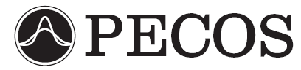
Sensitivity Analysis for DSMC Simulations of High-Temperature Air Chemistry
James S. Strand and David B. Goldstein
The University of Texas at Austin
Sponsored by the Department of Energy through the PSAAP Program
Predictive Engineering and Computational Sciences
Computational Fluid Physics Laboratory

Slide 2
Motivation – DSMC Parameters
The DSMC model includes many parameters related to gas dynamics at the molecular level, such as:
  Elastic collision cross-sections.
  Vibrational and rotational excitation cross-sections.
  Reaction cross-sections.
  Sticking coefficients and catalytic efficiencies for gas-surface interactions.
  …etc.

Slide 3
DSMC Parameters
In many cases the precise values of some of these parameters are not known.
Parameter values often cannot be directly measured, instead they must be inferred from experimental results.
By necessity, parameters must often be used in regimes far from where their values were determined.
More precise values for important parameters would lead to better simulation of the physics, and thus to better predictive capability for the DSMC method.

Slide 4
MCMC Method - Overview
Markov Chain Monte Carlo (MCMC) is a method which solves the statistical inverse problem in order to calibrate parameters with respect to a set or sets of experimental data.

Slide 5
MCMC Method
Establish boundaries for parameter space
Candidate Rejected
Candidate Accepted
Accept or reject candidate position based on a random number draw
Select initial position
Current position remains unchanged.
Candidate position becomes current position
Run simulation at current position
Prob_{candidate}
< Prob_{current}
Calculate probability for current position
Select new candidate position
Run simulation for candidate position parameters, and calculate probability
Prob_{candidate}
> Prob_{current}
Candidate position is accepted, and becomes the current chain position
Candidate automatically accepted

Slide 6
Previous MCMC Results – Argon VHS Parameters
P. Valentini, T. E. Schwartzentruber, Physics of Fluids (2009), Vol. 21

Slide 7
Sensitivity Analysis - Overview
In the current context, the goal of sensitivity analysis is to determine which parameters most strongly affect a given quantity of interest (QoI).
Only parameters to which a given QoI is sensitive will be informed by calibrations based on data for that QoI.
Sensitivity analysis is used here both to determine which parameters to calibrate in the future, and to select the QoI which would best inform the parameters we most wish to calibrate.

Slide 8
Numerical Methods – DSMC Code
Our DSMC code can model flows with rotational and vibrational excitation and relaxation, as well as five-species air chemistry, including dissociation, exchange, and recombination reactions.
Larsen-Borgnakke model is used for redistribution between rotational, translational, and vibrational modes during inelastic collisions.
TCE model provides cross-sections for chemical reactions.

Slide 9
Variable Hard Sphere Model
The VHS model allows the collision cross-section to be dependent on relative speed, which is more physically realistic than the hard sphere model.
There are two relevant parameters for the VHS model, d_{ref} and ω.

Slide 10
Internal Modes
Rotation is assumed to be fully excited.
  Each particle has its own value of rotational energy, and this variable is continuously distributed.
Vibrational levels are quantized.
  Each particle has its own vibrational level, which is associated with a certain vibrational energy based on the simple harmonic oscillator model.
Relevant parameters are Z_{R} and Z_{V}, the rotational and vibrational collision numbers.
  Z_{R} = 1/Λ_{R}, where Λ_{R} is the probability of the rotational energy of a given molecule being redistributed during a given collision.
  Z_{V} = 1/Λ_{V}
  Z_{R} and Z_{V} are treated as constants.

Slide 11
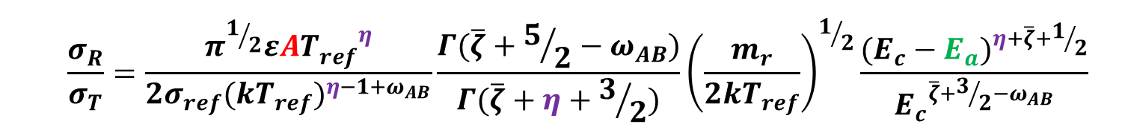

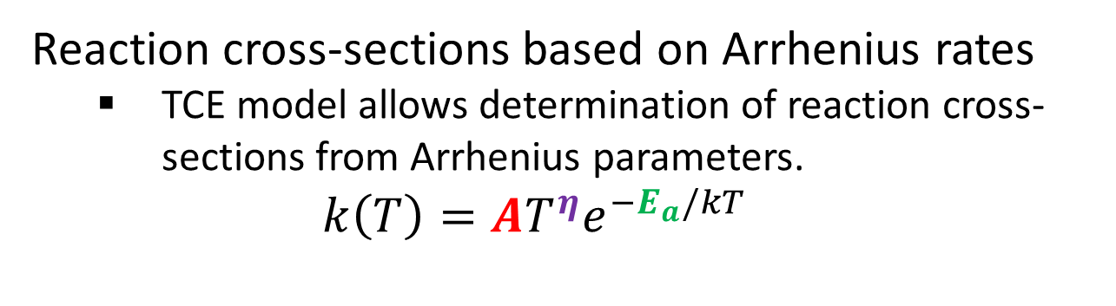
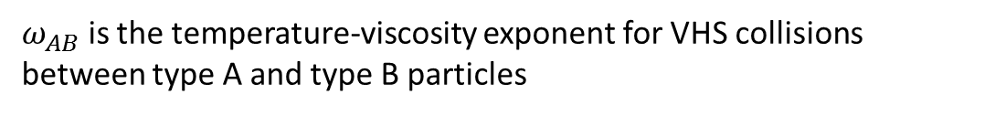
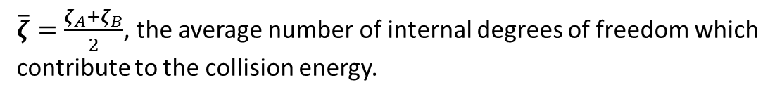
Chemistry Implementation
Reaction cross-sections based on Arrhenius rates
  TCE model allows determination of reaction cross-sections from Arrhenius parameters.
  $$k\left(T\right)=AT^{η}e^{−E_{a}/kT}$$
  $$\frac{σ_{R}}{σ_{T}}=\frac{π^{1/2}εA{T_{ref}^{}}^{η}}{2σ_{ref}{(kT_{ref})}^{η−1+ω_{AB}}}\frac{Γ(\overline{ζ}+5/2−ω_{AB})}{Γ(\overline{ζ}+η+3/2)}{\left(\frac{m_{r}}{2kT_{ref}}\right)}^{1/2}\frac{{(E_{c}−E_{a})}^{η+\overline{ζ}+1/2}}{{E_{c}}^{\overline{ζ}+3/2−ω_{AB}}}$$
σ_{R} and σ_{T} are the reaction and total cross-sections, respectively
$\overline{ζ}=\frac{ζ_{A}+ζ_{B}}{2}$, the average number of internal degrees of freedom which
contribute to the collision energy.
$$ε=1 \left(if A≠B\right)or 2 \left(if A=B\right)$$
$$σ_{ref} and T_{ref} are both constants related to the VHS collision model$$
$ω_{AB}$ is the temperature-viscosity exponent for VHS collisions between type A and type B particles
k is the Boltzmann constant, m_{r} is the reduced mass of particles A and B, E_{c} is the collision energy, and Γ() is the gamma function.

Slide 12

Reactions
$$k\left(T\right)=AT^{η}e^{−E_{a}/kT}$$
T. Ozawa, J. Zhong, and D. A. Levin, Physics of Fluids (2008), Vol. 20, Paper #046102.

Slide 13
Reaction Rates – Nitrogen Dissociation

Slide 14

Reaction Rates – O₂ and NO Dissociation
$$σ_{R}≮σ_{VHS}$$

Slide 15

Reaction Rates – NO Exchange Reactions
$$σ_{R}≮σ_{VHS}$$

Slide 16
Parallelization
DSMC:
    MPI parallel.
    Ensemble averaging to reduce stochastic noise.
    Fast simulation of small problems.
Sensitivity Analysis:
    MPI Parallel
    Separate processor groups for each parameter.
    Large numbers of parameters can be examined simultaneously.

Slide 17
0-D Relaxation, Pure Nitrogen
Scenarios examined in this work are 0-D relaxations from an initial high-temperature state.
0-D box is initialized with 100% N₂.
  Initial number density = 1.0×10²³ #/m³.
  Initial translational temperature = ~50,000 K.
  Initial rotational and vibrational temperatures are both 300 K.
Scenario is a 0-D substitute for a hypersonic shock at ~8 km/s.
  Assumption that the translational modes equilibrate much faster than the internal modes.

Slide 18
0-D Relaxation, Pure Nitrogen

Slide 19
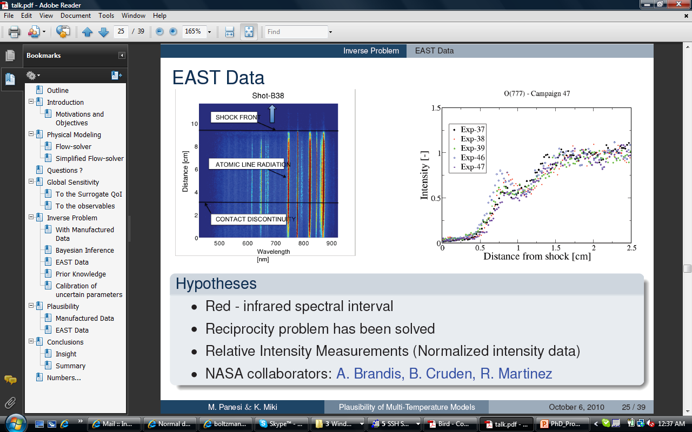
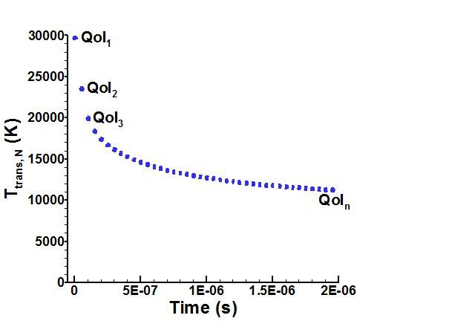
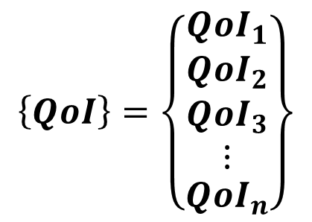
Quantity of Interest (QoI)
$$\left\{QoI\right\}=\left\{\begin{matrix}{QoI}_{1} \\ \begin{matrix}{QoI}_{2} \\ \begin{matrix}{QoI}_{3} \\ ⋮\end{matrix}\end{matrix} \\ {QoI}_{n}\end{matrix}\right\}$$
J. Grinstead, M. Wilder, J. Olejniczak, D. Bogdanoff, G. Allen, and K. Danf, AIAA Paper 2008-1244, 2008.

Slide 20
Sensitivity Analysis - QoI
ω_{min}
ω_{nom}
ω_{max}
d_{ref,min}
d_{ref,nom}
d_{ref,max}
Z_{R,min}
Z_{R,nom}
Z_{R,max}
Z_{V,min}
Z_{V,nom}
Z_{V,max}

Slide 21
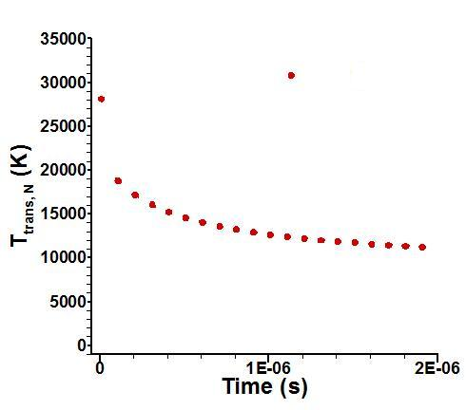
Sensitivity Analysis – Type 1
ω_{min}
ω_{nom}
ω_{max}
ω = ω_{min}
ω_{min}
d_{ref,min}
d_{ref,nom}
d_{ref,max}
d_{ref} = d_{ref,nom}
Z_{R,min}
Z_{R,nom}
Z_{R,max}
Z_{R} = Z_{R,nom}
Z_{V,min}
Z_{V,nom}
Z_{V,max}
Z_{V} = Z_{V,nom}

Slide 22
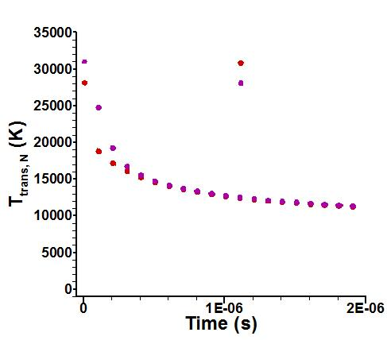
Sensitivity Analysis – Type 1
ω_{min}
ω_{nom}
ω_{max}
ω = ω_{max}
ω_{min}
d_{ref,min}
d_{ref,nom}
d_{ref,max}
ω_{max}
d_{ref} = d_{ref,nom}
Z_{R,min}
Z_{R,nom}
Z_{R,max}
Z_{R} = Z_{R,nom}
Z_{V,min}
Z_{V,nom}
Z_{V,max}
Z_{V} = Z_{V,nom}

Slide 23
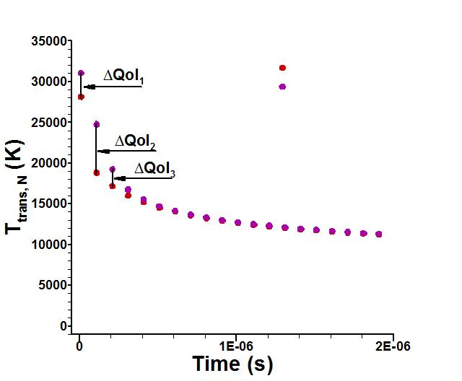
Sensitivity Analysis – Type 1
ω_{min}
ω_{max}
ω_{min}
ω_{nom}
ω_{max}
Δω = ω_{max} – ω_{min}

Slide 24

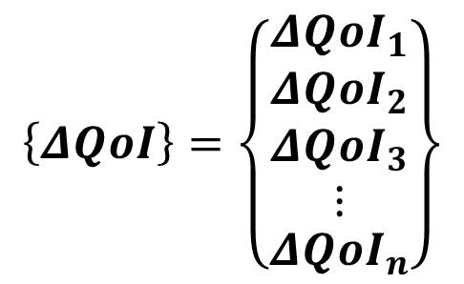
Sensitivity Analysis – Type 1
$$\left\{ΔQoI\right\}=\left\{\begin{matrix}{ΔQoI}_{1} \\ \begin{matrix}{ΔQoI}_{2} \\ \begin{matrix}{ΔQoI}_{3} \\ ⋮\end{matrix}\end{matrix} \\ {ΔQoI}_{n}\end{matrix}\right\}$$
ΔQoI₂
ΔQoI₁
ΔQoI₃
ΔQoI_{n}
ω_{min}
ω_{nom}
ω_{max}
$$Sensitivity={\left\{ΔQoI\right\}}^{T}\left\{ΔQoI\right\}$$
Δω = ω_{max} – ω_{min}

Slide 25
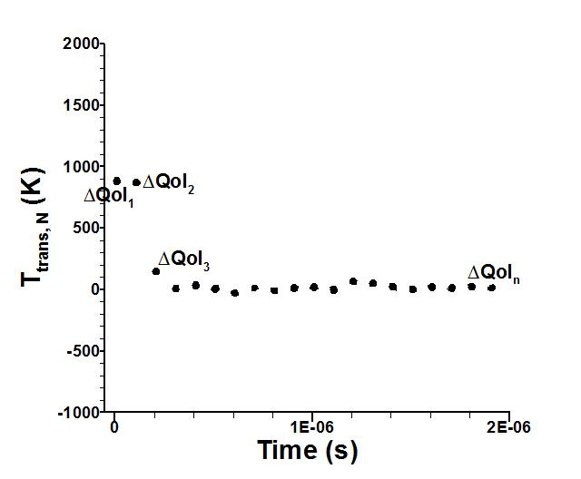

Sensitivity Analysis – Type 2
$$\left\{ΔQoI\right\}=\left\{\begin{matrix}{ΔQoI}_{1} \\ \begin{matrix}{ΔQoI}_{2} \\ \begin{matrix}{ΔQoI}_{3} \\ ⋮\end{matrix}\end{matrix} \\ {ΔQoI}_{n}\end{matrix}\right\}$$
ω_{min}
ω_{nom}
ω_{max}
$$Sensitivity={\left\{ΔQoI\right\}}^{T}\left\{ΔQoI\right\}$$
Δω = (ω_{max} – ω_{min})×0.10

Slide 26
Pure Nitrogen – Parameters

Slide 27
Pure Nitrogen – Results
1.00
≈
≈
0.77
α₁
(N₂ + N₂ → N₂ + N + N)
α₂
(N + N₂ → N + N + N)
d_{ref} (N₂-N₂)
ω (N₂-N₂)
Z_{V}
Numerical Parameters
Z_{R}
Sensitivity Analysis Type 1

Slide 28
Pure Nitrogen – Results
1.00
≈
≈
0.53
α₁
(N₂ + N₂ → N₂ + N + N)
α₂
(N + N₂ → N + N + N)
Z_{V}
d_{ref} (N₂-N₂)
ω (N₂-N₂)
Numerical Parameters
Z_{R}
Sensitivity Analysis Type 2

Slide 29
Pure Nitrogen – Results

Slide 30
0-D Relaxation, Five-Species Air
Another 0-D relaxation from an initial high-temperature state.
0-D box is initialized with 79% N₂, 21% O₂.
  Initial bulk number density = 1.0×10²³ #/m³.
  Initial bulk translational temperature = ~50,000 K.
  Initial bulk rotational and vibrational temperatures are both 300 K.
Scenario is a 0-D substitute for a hypersonic shock at ~8 km/s.
  Assumption that the translational modes equilibrate much faster than the internal modes.

Slide 31
Five-Species Air – Densities

Slide 32
Five-Species Air – Translational Temperatures

Slide 33


Five-Species Air - Parameters
$$k\left(T\right)=AT^{η}e^{−E_{a}/kT}$$
$${10}^{α}=A$$

Slide 34
Five-Species Air - Results
We used only sensitivity analysis type 2 for the five species air scenario.
N₂ + O → NO + N
Nitrogen Dissociation Reactions
NO Dissociation Reactions
NO + N → N₂ + O
Oxygen Dissociation Reactions
Numerical Parameters
NO Exchange Reactions
QoI = T_{trans,N}

Slide 35
Five-Species Air - Results
We also tested sensitivity with respect to a second QoI, the mass density of NO.
N₂ + O → NO + N
NO + N → N₂ + O
NO Dissociation Reactions
Nitrogen Dissociation Reactions
Oxygen Dissociation Reactions
Numerical Parameters
NO Exchange Reactions
QoI = ρ_{NO}

Slide 36
Five-Species Air - Results

Slide 37
Conclusions
Pure nitrogen scenario:
Sensitivities to reaction rates dominate all others.
Z_{R}, Z_{V}, and VHS parameters for N₂-N₂ collisions are important in the early stages of the relaxation.
Five-species air scenario:
Sensitivities for the forward and backward rates for the reaction N₂ + O ↔ NO + N are dominant when using either T_{trans,N} or ρ_{NO} as the QoI.
NO dissociation reactions are moderatly important for either QoI.
Nitrogen and oxygen dissociation reactions are important only for the T_{trans,N} QoI.

Slide 38
Future Work
Perform calibration with synthetic data for the 0-D relaxation scenarios.
Perform synthetic data calibrations for a 1-D shock with chemistry.
Perform calibrations with real data from EAST or similar facility.

