Slide 1

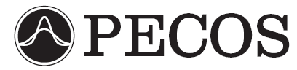
Bayesian Inference For The Calibration Of DSMC Parameters
James S. Strand and David B. Goldstein
The University of Texas at Austin
Sponsored by the Department of Energy through the PSAAP Program
Predictive Engineering and Computational Sciences
Computational Fluid Physics Laboratory

Slide 2
Motivation – DSMC Parameters
The DSMC model includes many parameters related to gas dynamics at the molecular level, such as:
  Elastic collision cross-sections.
  Vibrational and rotational excitation probabilities.
  Reaction cross-sections.
  Sticking coefficients and catalytic efficiencies for gas-surface interactions.
  …etc.

Slide 3
DSMC Parameters
In many cases the precise values of some of these parameters are not known.
Parameter values often cannot be directly measured, instead they must be inferred from experimental results.
By necessity, parameters must often be used in regimes far from where their values were determined.
More precise values for important parameters would lead to better simulation of the physics, and thus to better predictive capability for the DSMC method. The ultimate goal of this work is to use experimental data to calibrate important DSMC parameters.

Slide 4
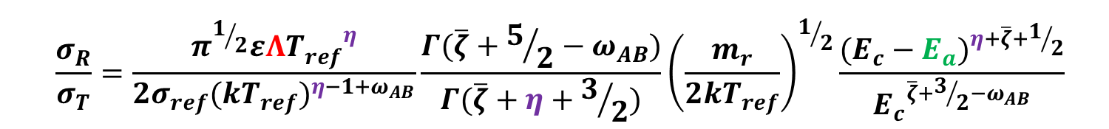

Numerical Methods – DSMC Code
Our DSMC code can model flows with rotational and vibrational excitation and relaxation, as well as five-species air chemistry, including dissociation, exchange, and recombination reactions.
Larsen-Borgnakke model is used for redistribution between rotational, translational, and vibrational modes during inelastic collisions.
  TCE model allows cross-sections for chemical reactions to be derived from Arrhenius parameters.
$$k\left(T\right)=ΛT^{η}e^{−E_{a}/kT}$$
  $$\frac{σ_{R}}{σ_{T}}=\frac{π^{1/2}εΛ{T_{ref}^{}}^{η}}{2σ_{ref}{(kT_{ref})}^{η−1+ω_{AB}}}\frac{Γ(\overline{ζ}+5/2−ω_{AB})}{Γ(\overline{ζ}+η+3/2)}{\left(\frac{m_{r}}{2kT_{ref}}\right)}^{1/2}\frac{{(E_{c}−E_{a})}^{η+\overline{ζ}+1/2}}{{E_{c}}^{\overline{ζ}+3/2−ω_{AB}}}$$

Slide 5

Reactions
$$k\left(T\right)=ΛT^{η}e^{−E_{a}/kT}$$
R. Gupta, J. Yos, and R. Thompson, NASA Technical Memorandum 101528, 1989.

Slide 6
Sensitivity Analysis - Overview
In the current context, the goal of sensitivity analysis is to determine which parameters most strongly affect a given quantity of interest (QoI).
Only parameters to which a given QoI is sensitive will be informed by calibrations based on data for that QoI.

Slide 7
Scenario: 1-D Shock
Shock speed is ~8000 m/s, M∞ ≈ 23.
  Upstream number density = 3.22×10²¹ #/m³.
  Upstream composition by volume: 79% N₂, 21% O₂.
  Upstream temperature = 300 K.

Slide 8
1D Shock Simulation
We require the ability to simulate a 1-D shock without knowing the post-shock conditions a priori.
To this end, we simulate an unsteady 1-D shock, and make use of a sampling region which moves with the shock.

Slide 9
Results: Nominal Parameter Values

Slide 10
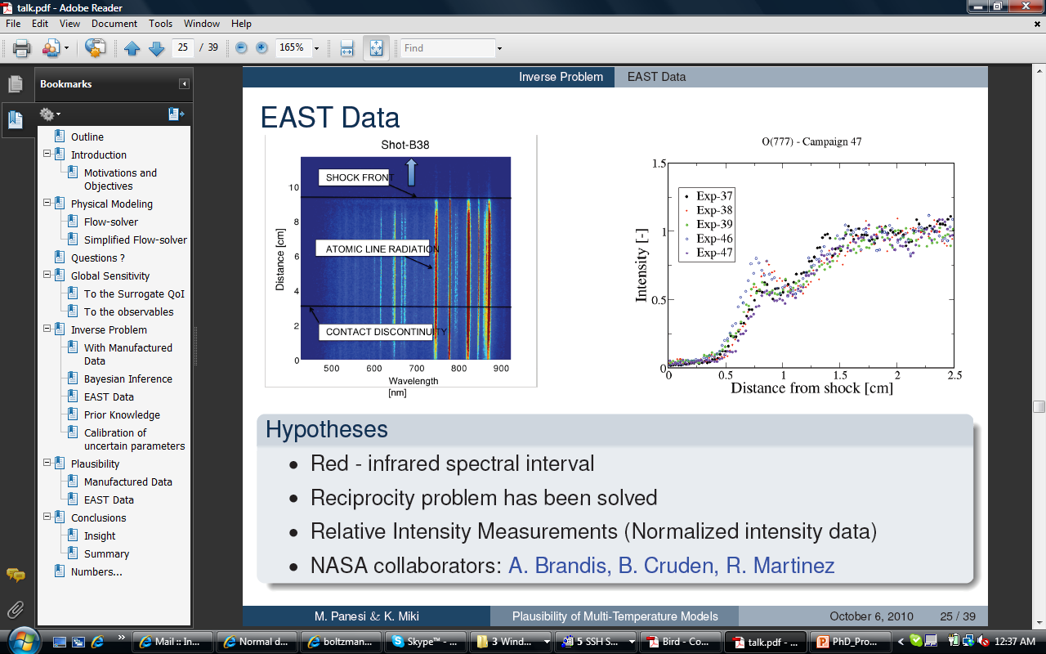
Quantity of Interest (QoI)
We cannot yet simulate EAST
or other shock tube results,
so we must choose a
temporary, surrogate QoI.
?
J. Grinstead, M. Wilder, J. Olejniczak, D. Bogdanoff, G. Allen, and K. Danf, AIAA Paper 2008-1244, 2008.

Slide 11
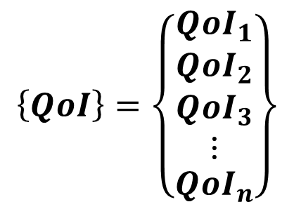
Sensitivity Analysis - Scalar vs. Vector QoI
The density of NO (our QoI for this work) is a vector, with values over a range of points in space.
$$\left\{QoI\right\}=\left\{\begin{matrix}{QoI}_{1} \\ \begin{matrix}{QoI}_{2} \\ \begin{matrix}{QoI}_{3} \\ ⋮\end{matrix}\end{matrix} \\ {QoI}_{n}\end{matrix}\right\}$$

Slide 12
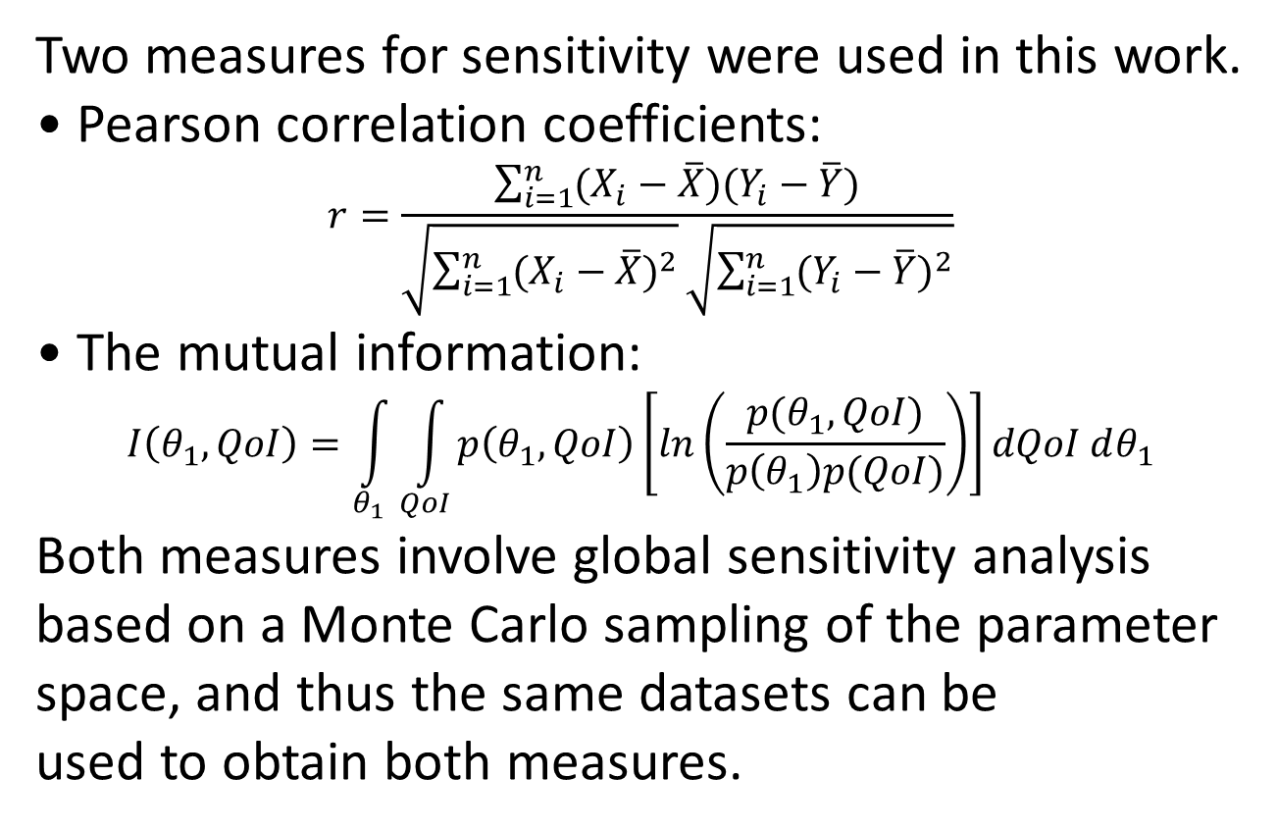
Sensitivity Analysis - Methods
Two measures for sensitivity were used in this work.
Pearson correlation coefficients:
$$r=\frac{\sum_{i=1}^{n}{(X_{i}−\overline{X})(Y_{i}−\overline{Y})}}{\sqrt{\sum_{i=1}^{n}{{(X_{i}−\overline{X})}^{2}}}\sqrt{\sum_{i=1}^{n}{{(Y_{i}−\overline{Y})}^{2}}}}$$
The mutual information:
$$I\left(θ_{1},QoI\right)=\int_{θ_{1}}^{ }{\int_{QoI}^{ }{p\left(θ_{1},QoI\right)\left[ln\left(\frac{p(θ_{1},QoI)}{p\left(θ_{1}\right)p(QoI)}\right)\right]}}dQoI dθ_{1}$$
Both measures involve global sensitivity analysis based on a Monte Carlo sampling of the parameter space, and thus the same datasets can be
used to obtain both measures.

Slide 13
Sensitivity Analysis: Correlation Coefficient

Slide 14
Sensitivity Analysis: Mutual Information

Slide 15
Sensitivity Analysis: Mutual Information

Slide 16
Sensitivity Analysis: Mutual Information

Slide 17

Sensitivity Analysis: Mutual Information
Actual joint PDF
of θ₁ and the
QoI, from a
Monte Carlo
sampling of the
parameter space.
Actual joint PDF
of θ₁ and the
QoI, from a
Monte Carlo
sampling of the
parameter space.
QoI
Kullback-Leibler divergence
$$p\left(θ_{1},QoI\right)\left[ln\left(\frac{p(θ_{1},QoI)}{p\left(θ_{1}\right)p(QoI)}\right)\right]$$
Hypothetical joint
PDF for case
where the QoI is
indepenent of θ₁.
Hypothetical joint
PDF for case where
the QoI is
indepenent of θ₁.
θ₁
$$I\left(θ_{1},QoI\right)=\int_{θ_{1}}^{ }{\int_{QoI}^{ }{p\left(θ_{1},QoI\right)\left[ln\left(\frac{p(θ_{1},QoI)}{p\left(θ_{1}\right)p(QoI)}\right)\right]}}dQoI dθ_{1}$$

Slide 18
Overall Sensitivities

Slide 19
Overall Sensitivities

Slide 20
Synthetic Data Calibrations: 0-D Relaxation
Due to computational constraints, a 0-D relaxation from an initial high-temperature state is used for the synthetic data calibrations.
0-D box is initialized with 79% N₂, 21% O₂.
  Initial bulk number density = 1.0×10²³ #/m³.
  Initial bulk translational temperature = ~50,000 K.
  Initial bulk rotational and vibrational temperatures are both 300 K.
Scenario is a 0-D substitute for a hypersonic shock at ~8 km/s.
  Assumption that the translational modes equilibrate much faster than the internal modes.
Sensitivity analysis of the type discussed earlier was used to identify parameters for calibration.

Slide 21
Synthetic Data
We once again use ρ_{NO} as our QoI.

Slide 22
MCMC Method - Overview
Markov Chain Monte Carlo (MCMC) is a method which solves the statistical inverse problem in order to calibrate parameters with respect to a set or sets of data.
The likelihood of a given set of parameters is calculated based on the mismatch between the data and the simulation results for that set of parameters.
One or more chains explore the parameter space, moving towards regions of higher likelihood.

Slide 23
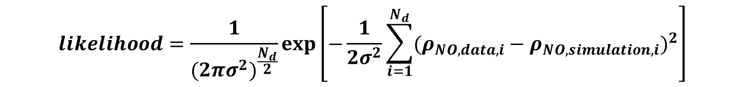
Synthetic Data Calibrations
$$likelihood=\frac{1}{{(2πσ^{2})}^{\frac{N_{d}}{2}}}exp\left[−\frac{1}{2σ^{2}}\sum_{i=1}^{N_{d}}{{(ρ_{NO,data,i}−ρ_{NO,simulation,i})}^{2}}\right]$$

Slide 24
Synthetic Data Calibrations

Slide 25
Synthetic Data Calibrations

Slide 26
Conclusions
Global, Monte Carlo based sensitivity analysis can provide a great deal of insight into how various parameters affect a given QoI.
A great deal of computer power is required to perform this type of statistical analysis for DSMC shock simulations.
  5,000 shocks were run for this sensitivity analysis.
  Required a total of ~320,000 CPU hours.
MCMC can be used to calibrate at least some DSMC parameters based on synthetic data for a 0-D relaxation.
MCMC allows for propagation of uncertainty from the data to the final parameter PDFs.

Slide 27
Future Work
Synthetic data calibrations for a 1-D shock with the current code.
Upgrade the code to allow modeling of ionization and electronic excitation.
Couple the code with a radiation solver.
Sensitivity analysis for a 1-D shock with the additional physics included.
Synthetic data calibrations with the upgraded code.
Calibrations with real data from EAST or similar facility.

