Slide 1

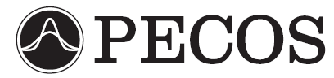
Statistical Methods for the Analysis of DSMC Simulations of Hypersonic Shocks
James S. Strand
The University of Texas at Austin
Funding and Computational Resources Provided by the Department of Energy through the PSAAP Program
Predictive Engineering and Computational Sciences
Computational Fluid Physics Laboratory

Slide 2
Introduction - DSMC
Direct Simulation Monte Carlo (DSMC) is a stochastic, particle based method for simulating gas dynamics.
Simulated particles represent large numbers of real particles.
Particles move and interact with other particles.
Interactions between particles (such as elastic or inelastic collisions and chemical reactions) are handled statistically.

Slide 3
Motivation: Why Use DSMC?
DSMC is often the only realistic option for simulation of the rarefied flows which occur in a diverse set of fields. Examples include the high-altitude portion of atmospheric re-entry, space station plume impingement, flow in MEMS devices, and planetary atmospheres.
DSMC provides accurate simulation of highly non-equilibrium regions of a flowfield (such as strong shock waves).
DSMC can model thermochemistry on a more detailed level than most CFD codes.

Slide 4
Motivation – DSMC Parameters
The DSMC model includes many parameters related to gas dynamics at the molecular level, such as:
  Elastic collision cross-sections.
  Vibrational and rotational excitation probabilities.
  Reaction cross-sections.
  Sticking coefficients and catalytic efficiencies for gas-surface interactions.
  …etc.

Slide 5
Motivation – DSMC Parameters
In many cases the precise values of some of these parameters are not known.
Parameter values often cannot be directly measured, instead they must be inferred from experimental results.
By necessity, parameters must often be used in regimes far from where their values were determined.
More precise values for important parameters would lead to better simulation of the physics, and thus to better predictive capability for the DSMC method. The ultimate goal of this project is to use experimental data to calibrate DSMC parameters relevant to the simulation of hypersonic shocks.

Slide 6
Motivation – General
Aside from the specific long-term goal of calibrating DSMC parameters based on experimental data, we have two more general objectives as well:
To demonstrate a sensitivity analysis methodology which can be used for complex physical problems related to gas dynamics.
To demonstrate that making use of multiple types of data from multiple scenarios can be helpful when solving the inverse problem in order to calibrate parameters.

Slide 7
DSMC Method
Performed on
First Time Step
Initialize
Create
Move
Performed on
Every Time Step
Index
Collide
Sample
Performed on
Selected Time Steps

Slide 8
Particle Interactions in DSMC
Interactions between particles are performed statistically in DSMC. Pairs of particles are randomly selected from within a cell, and a random number draw determines whether or not the particles interact, and if so, which type of interaction occurs.

Slide 9
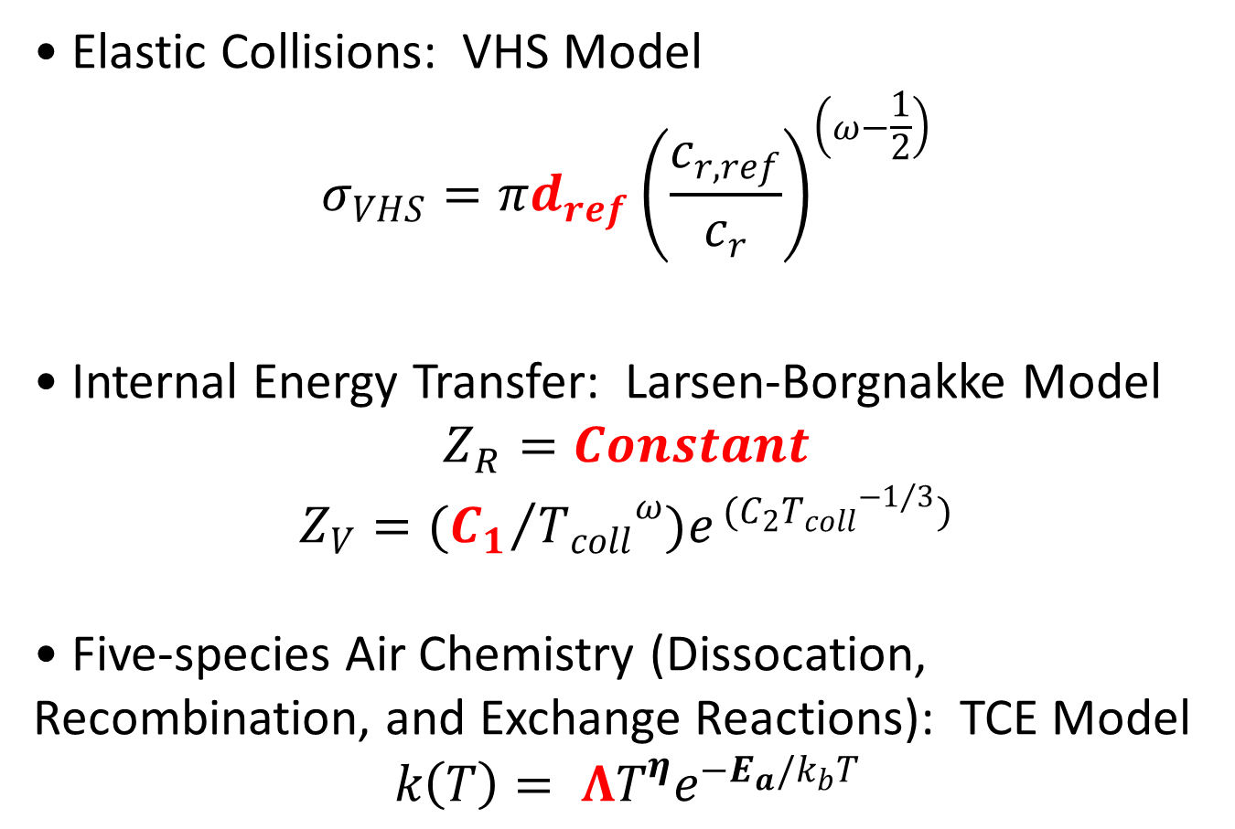
Particle Interaction Models and Parameters
Elastic Collisions: VHS Model
$$σ_{VHS}=πd_{ref}{\left(\frac{c_{r,ref}}{c_{r}}\right)}^{\left(ω−\frac{1}{2}\right)}$$
Internal Energy Transfer: Larsen-Borgnakke Model
$$Z_{R}=Constant$$
$$Z_{V}=({C_{1}}/{{T_{coll}}^{ω})e^{ (C_{2}{T_{coll}}^{{−1}/3})}}$$
Five-species Air Chemistry (Dissocation, Recombination, and Exchange Reactions): TCE Model
$$k\left(T\right)= ΛT^{η}e^{−E_{a}/k_{b}T}$$

Slide 10
Sensitivity Analysis - Overview
The purpose of the sensitivity analyses presented in this work was to determine which parameters most strongly affect the simulation results for a given scenario and quantity of interest (QoI).
We will choose which parameters to calibrate based on the results of our sensitivity analyses.

Slide 11
Global Sensitivity Analysis
In this work we use a global sensitivity analysis methodology. In a global sensitivity analysis all of the parameters are varied simultaneously.
Each parameter is assigned a distribution, called the prior, which reflects the level of uncertainty for that parameter (based on literature values and expert judgment). During the sensitivity analysis the parameters take on values drawn from this prior, rather than in a small region about a nominal value.

Slide 12
Sampling the Parameter Space
Our global sensitivity analysis requires a Monte Carlo sampling of the parameter space. For each sample point, a set of random number draws is performed to determine the values of all of the parameters.
A simulation is then run with this set of parameter values, and the results for the QoI are output.
Once a reasonable number of sample points have been completed, we can create scatterplots for the relationship between each parameter and the QoI.

Slide 13
Sampling the Parameter Space

Slide 14
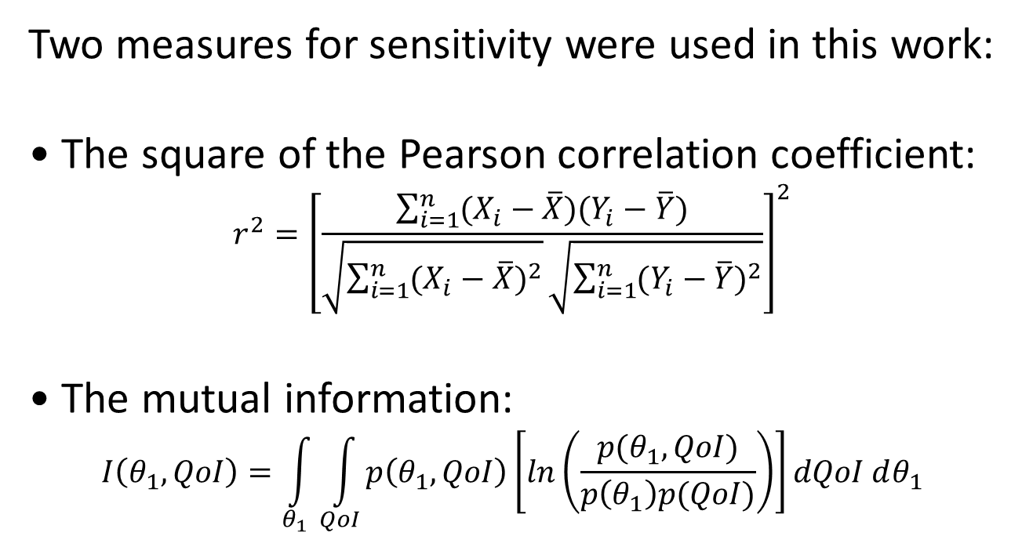
Sensitivity Analysis – Measures of Sensitivity
Two measures for sensitivity were used in this work:
The square of the Pearson correlation coefficient:
$$r^{2}={\left[\frac{\sum_{i=1}^{n}{(X_{i}−\overline{X})(Y_{i}−\overline{Y})}}{\sqrt{\sum_{i=1}^{n}{{(X_{i}−\overline{X})}^{2}}}\sqrt{\sum_{i=1}^{n}{{(Y_{i}−\overline{Y})}^{2}}}}\right]}^{2}$$
The mutual information:
$$I\left(θ_{1},QoI\right)=\int_{θ_{1}}^{ }{\int_{QoI}^{ }{p\left(θ_{1},QoI\right)\left[ln\left(\frac{p(θ_{1},QoI)}{p\left(θ_{1}\right)p(QoI)}\right)\right]}}dQoI dθ_{1}$$

Slide 15
Sensitivity Analysis: r²

Slide 16
Sensitivity Analysis: Mutual Information

Slide 17
Sensitivity Analysis: Mutual Information

Slide 18
Sensitivity Analysis: Mutual Information

Slide 19

Sensitivity Analysis: Mutual Information
Actual joint PDF
of θ₁ and the
QoI, from a
Monte Carlo
sampling of the
parameter space.
Actual joint PDF
of θ₁ and the
QoI, from a
Monte Carlo
sampling of the
parameter space.
QoI
Kullback-Leibler divergence
$$p\left(θ_{1},QoI\right)\left[ln\left(\frac{p(θ_{1},QoI)}{p\left(θ_{1}\right)p(QoI)}\right)\right]$$
Hypothetical joint
PDF for case
where the QoI is
indepenent of θ₁.
Hypothetical joint
PDF for case where
the QoI is
indepenent of θ₁.
θ₁
$$I\left(θ_{1},QoI\right)=\int_{θ_{1}}^{ }{\int_{QoI}^{ }{p\left(θ_{1},QoI\right)\left[ln\left(\frac{p(θ_{1},QoI)}{p\left(θ_{1}\right)p(QoI)}\right)\right]}}dQoI dθ_{1}$$

Slide 20
0-D Relaxation Scenario
0-D box is initialized with 79% N₂, 21% O₂.
  Initial bulk number density = 1.0×10²³ #/m³.
  Initial bulk translational temperature = ~50,000 K.
  Initial bulk rotational and vibrational temperatures are both 300 K, based on the assumption that in a shock the translational modes equilibrate faster than the internal modes.
Scenario is intended to be a 0-D substitute for a hypersonic shock at ~8 km/s.

Slide 21
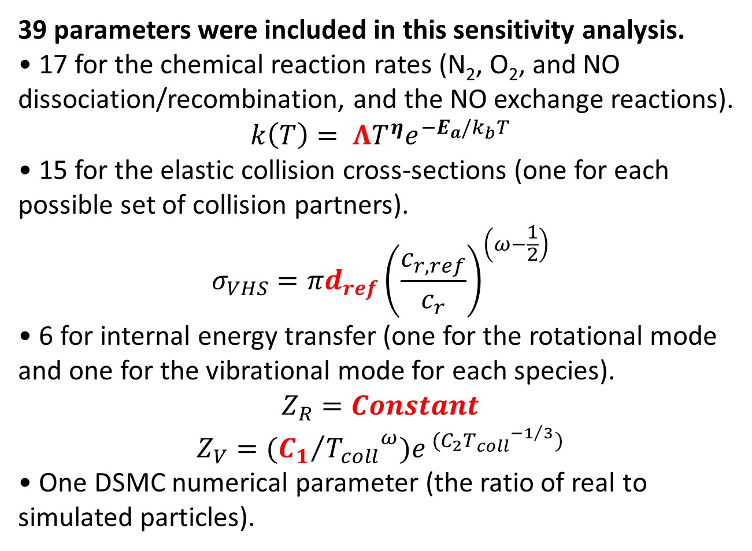
Parameters for the 0-D Relaxation
Sensitivity Analysis
39 parameters were included in this sensitivity analysis.
17 for the chemical reaction rates (N₂, O₂, and NO dissociation/recombination, and the NO exchange reactions).
$$k\left(T\right)= ΛT^{η}e^{−E_{a}/k_{b}T}$$
15 for the elastic collision cross-sections (one for each possible set of collision partners).
$$σ_{VHS}=πd_{ref}{\left(\frac{c_{r,ref}}{c_{r}}\right)}^{\left(ω−\frac{1}{2}\right)}$$
6 for internal energy transfer (one for the rotational mode and one for the vibrational mode for each species).
$$Z_{R}=Constant$$
$$Z_{V}=({C_{1}}/{{T_{coll}}^{ω})e^{ (C_{2}{T_{coll}}^{{−1}/3})}}$$
One DSMC numerical parameter (the ratio of real to simulated particles).

Slide 22
Prior Distributions for the Parameters
The Λ parameters for the chemical reaction rates are given a prior which extends from 0.1×Λ_{nom} to 10×Λ_{nom}, with Λ_{nom} for each reaction obtained from Gupta et al. (1989). Since we are varying Λ for each reaction over two orders of magnitude we will actually check sensitivity to log₁₀Λ.
The d_{ref} parameters for the elastic collision cross-sections are given a prior which extends from 0.5×d_{ref,nom} to 1.5×d_{ref,nom}, with values of d_{ref,nom} from Ozawa (2008).
R. Gupta, J. Yos, and R. Thompson, NASA Technical Memorandum 101528, 1989.
T. Ozawa, J. Zhong, and D. A. Levin, Physics of Fluids, Vol. 20, 2008.

Slide 23
Prior Distributions for the Parameters - Continued
The constant which is used as the value for Z_{R} and the constant C₁ in the equation for Z_{V} both are given priors which extend over a two-order of magnitude range, and thus we actually check sensitivity to log₁₀Z_{R} and log₁₀C₁. Nominal values for C₁ are from Bird (1994) and the nominal values for Z_{R} are based on our own intuition.
The ratio of real to simulated particles is given a prior which extends over a one order of magnitude range, and we actually check sensitivity to log₁₀(Ratio of Real to Simulated Particles). The nominal value for this numerical parameter is based on our own observations.
G. A. Bird, Molecular Gas Dynamics and the Direct Simulation of Gas Flows, Oxford Univ. Press. Oxford, 1994.

Slide 24
Results: Nominal Parameter Values

Slide 25
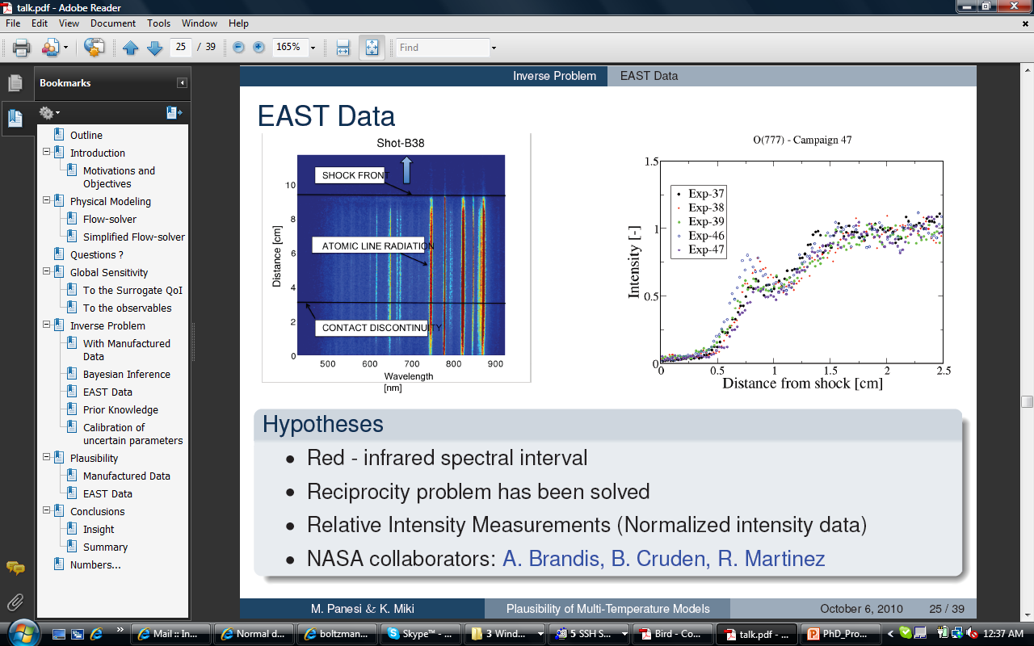
Quantity of Interest (QoI)
We cannot yet simulate NASA
EAST or other shock tube
results, so we must choose a
temporary, surrogate QoI.
?
J. Grinstead, M. Wilder, J. Olejniczak, D. Bogdanoff, G. Allen, and K. Danf, AIAA Paper 2008-1244, 2008.

Slide 26
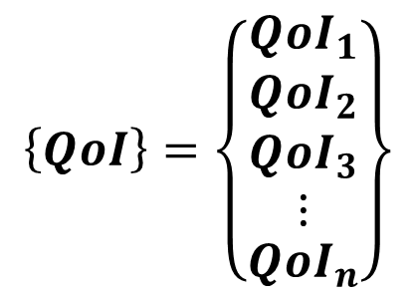
Sensitivity Analysis - Scalar vs. Vector QoI
We choose the density of NO as our QoI for this sensitivity analysis. This QoI is a vector, with values at discrete points in time during the course of the relaxation.
$$\left\{QoI\right\}=\left\{\begin{matrix}{QoI}_{1} \\ \begin{matrix}{QoI}_{2} \\ \begin{matrix}{QoI}_{3} \\ ⋮\end{matrix}\end{matrix} \\ {QoI}_{n}\end{matrix}\right\}$$

Slide 27
0-D Relaxation Sensitivity Analysis: Sampling the Parameter Space
Simulations were run for a total of 20,000 sample points in parameter space
This set of 20,000 runs of the DSMC code required a total of ~100,000 CPU hours.

Slide 28
Sensitivities vs. Time

Slide 29
Need for Variance-Weighted Sensitivities

Slide 30
Variance-Weighted Sensitivities vs. Time

Slide 31
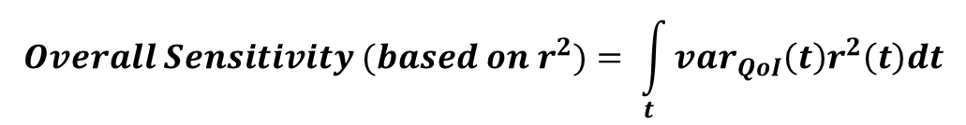
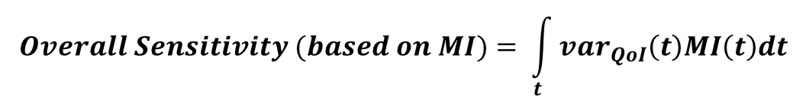
Overall Sensitivities
$$Overall Sensitivity (based on r^{2})= \int_{t}^{ }{{var}_{QoI}\left(t\right)r^{2}\left(t\right)dt}$$
$$Overall Sensitivity (based on MI)= \int_{t}^{ }{{var}_{QoI}\left(t\right)MI\left(t\right)dt}$$

Slide 32
Scenario: 1-D Shock
Shock speed is ~8000 m/s, M∞ ≈ 23.
  Upstream number density = 3.22×10²¹ #/m³.
  Upstream composition by volume: 79% N₂, 21% O₂.
  Upstream temperature = 300 K.

Slide 33
1D Shock Simulation
We require the ability to simulate a 1-D shock without knowing the post-shock conditions a priori.
To this end, we simulate an unsteady 1-D shock, and make use of a sampling region which moves with the shock.

Slide 34
Parameters, Prior Distributions, and QoI for the 1-D Shock Sensitivity Analysis
Based on the results of the 0-D relaxation sensitivity analysis, we choose to check sensitivities for only the 17 reaction rate parameters.
The prior distributions for those 17 parameters in the 1-D shock sensitivity analysis are the same as the prior distributions which were used previously for the 0-D relaxation sensitivity analysis.
We once again choose the NO density profile as our vector QoI in this sensitivity analysis.

Slide 35
1-D Shock Sensitivity Analysis: Sampling the Parameter Space
Simulations were run for a total of 5,600 sample points in parameter space
This set of 5600 runs of the DSMC code took over 112 hours on 4096 processors (each individual DSMC simulation was performed on 128 processors, and the runs were done simultaneously in multiple sets), for a total of ~450,000 CPU hours. (Remember that for the 0-D relaxation sensitivity analysis it took ~100,000 CPU hours to do 20,000 simulations).

Slide 36
Results: Nominal Parameter Values

Slide 37
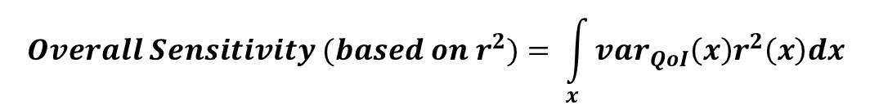
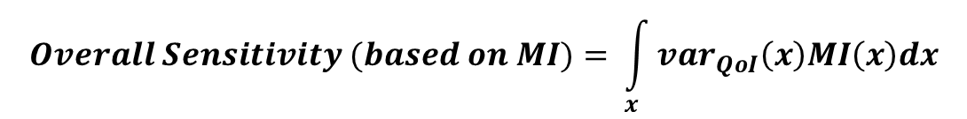
Overall Sensitivities
$$Overall Sensitivity (based on r^{2})= \int_{x}^{ }{{var}_{QoI}\left(x\right)r^{2}\left(x\right)dx}$$
$$Overall Sensitivity (based on MI)= \int_{x}^{ }{{var}_{QoI}\left(x\right)MI\left(x\right)dx}$$

Slide 38
Synthetic Data Calibrations
During the calibration process simulations must be run in sequence, and this makes calibrations for the 1-D shock very time consuming. For this reason, the 0-D relaxation scenario was used for the synthetic data calibrations.
The purpose of a synthetic data calibration is not to provide information about the parameters. The goal is to demonstrate that the inverse problem is solvable, meaning that we can meaningfully calibrate a set of parameters based on a set or sets of data.

Slide 39
Synthetic Data - Example
We use the ρ_{NO} vs. time profile as our synthetic data.

Slide 40
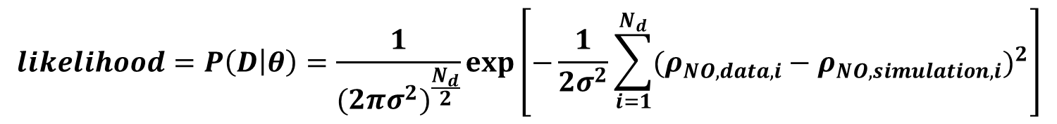
Likelihood Equation
$$likelihood=P\left(D | θ\right)=\frac{1}{{(2πσ^{2})}^{\frac{N_{d}}{2}}}exp\left[−\frac{1}{2σ^{2}}\sum_{i=1}^{N_{d}}{{(ρ_{NO,data,i}−ρ_{NO,simulation,i})}^{2}}\right]$$

Slide 41
MCMC Overview
Markov Chain Monte Carlo (MCMC) is a method which solves the statistical inverse problem in order to calibrate parameters with respect to a set of data.
The likelihood of a given set of parameters is calculated based on the mismatch between the data and the simulation results for that set of parameters.
One or more chains explore the parameter space, moving towards regions of higher likelihood.
Candidate positions are drawn from a multi-dimensional Gaussian proposal distribution centered at the current chain position. The covariance matrix of this Gaussian controls the average distance (in parameter space) that the chain moves in one step.

Slide 42
MCMC Flowchart: Metropolis-Hastings

Slide 43
Delayed Rejection Adaptive Metropolis
We use the PECOS-developed code QUESO, which implements two major additions to the basic Metropolis-Hastings algorithm. Both of these features can help improve the convergence of the method.
Delayed Rejection:
  When an initial candidate position is rejected, a second candidate position is generated based on a scaled proposal covariance matrix.
Adaptive Metropolis:
  At periodic intervals, the proposal covariance matrix is updated based on the calculated covariance of the previously accepted chain positions.
H. Haario, M. Laine, A. Mira, E. Saksman, Statistics and Computing, 16, 339-354 (2006).

Slide 44
Two Parameter Calibration: Chain Progression

Slide 45
Two Parameter Calibration: Post-Calibration PDFs
N₂ + O <--> NO + N
O₂ + N <--> NO + O

Slide 46
Six Parameter Calibration
We would like to calibrate the six parameters we identified based on the results of the sensitivity analyses. These six parameters are the pre-exponential constants in the Arrhenius rate equations for the following reactions:
N₂ + N ⇄ 3N
O₂ + O ⇄ 3O
NO + N ⇄ 2N + O
NO + O ⇄ N + 2O
N₂ + O ⇄ NO + N
NO + O ⇄ O₂ + N

Slide 47
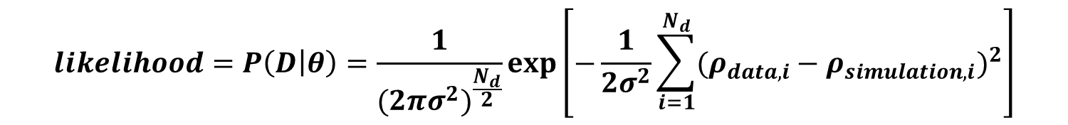
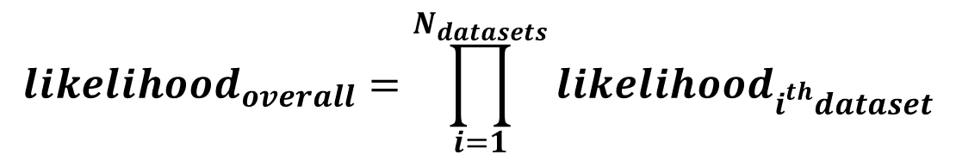
Six Parameter Calibration
We have found that we cannot properly calibrate all six of these parameters if we use only a single 0-D relaxation scenario and a density profile as our dataset.
In order to calibrate successfully, we include a second 0-D relaxation scenario, with an initial translational temperate of 30,000 K (instead of ~50,000 K for the original scenario). We use three sets of synthetic data from each of the two scenarios, namely the density vs. time profiles for N, O, and NO.
$$likelihood=P\left(D | θ\right)=\frac{1}{{(2πσ^{2})}^{\frac{N_{d}}{2}}}exp\left[−\frac{1}{2σ^{2}}\sum_{i=1}^{N_{d}}{{(ρ_{data,i}−ρ_{simulation,i})}^{2}}\right]$$
$${likelihood}_{overall}=\prod_{i=1}^{N_{datasets}}{{likelihood}_{i^{th}dataset}}$$

Slide 48
Six Parameter Calibration: Chains
Thirty-two 8,000 position long chains were used in the six parameter calibration, each with a random starting position in parameter space. Both delayed rejection and adaptation of the proposal covariance matrix were used to improve the convergence of the chains. The first 4,000 chain positions were discarded as a burn-in when calculating the posterior PDFs for the parameters.
Running the simulations for this calibration required four 16-hour, 4096 processor runs, for a total of more than 250,000 CPU hours.

Slide 49
Six Parameter Calibration: Posterior PDFs

Slide 50
Six Parameter Calibration: False Peaks

Slide 51
Conclusions
We can use a moving sample region to obtain a steady 1D shock profile from the simulation of an unsteady 1D shock. This technique does not require a priori knowledge of the post-shock conditions.
Global, Monte Carlo based sensitivity analyses can provide a great deal of insight into how various parameters affect a given QoI.
A good deal of computer power is required to perform this type of statistical analysis for DSMC shock simulations.
  20,000 relaxations and 5,600 shocks were run for the sensitivity analyses presented here, which required a total of ~550,000 CPU hours.

Slide 52
More Conclusions
MCMC can be used to calibrate DSMC parameters based on synthetic data for a 0-D relaxation.
It can be very effective to employ multiple types of data from multiple scenarios when calibrating parameters.
We can use the likelihoods calculated for the set of candidate positions for a chain in order to determine whether a secondary peak in the posterior PDF for a given parameter is real or whether it is a numerical artifact due to finite length chains.
Calibrating DSMC parameters is computationally expensive, with the six parameter calibration presented here requiring 250,000 CPU hours even for the 0-D relaxation scenario.

Slide 53
Potential Future Work
Synthetic data calibrations for a 1-D shock with the current code.
Upgrade the code to allow modeling of ionization and electronic excitation.
Couple the code with a radiation solver.
Sensitivity analysis for a 1-D shock with the additional physics included.
Synthetic data calibrations with the upgraded code.
Calibrations with real data from EAST or similar facility.

